Slide 1


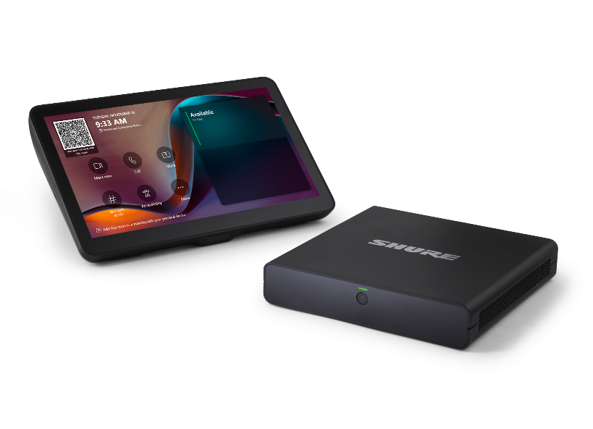

Thank You!
Notes:
Hi everyone, and welcome to Infocomm 25.
I am Ben Cook, I am honored to handle market development for Shure in the great white north. Canadians always love coming to Orlando in June, just in time for the first really humid sticky days of summer. If only we did Infocomm in a drier climate, oh wait, what? Oh, nevermind.
I better jump into it before I get myself in trouble up here!
I want to talk to you all about our newest most innovative products, but before I do, I want to show you a little piece of how we got here.

Slide 2
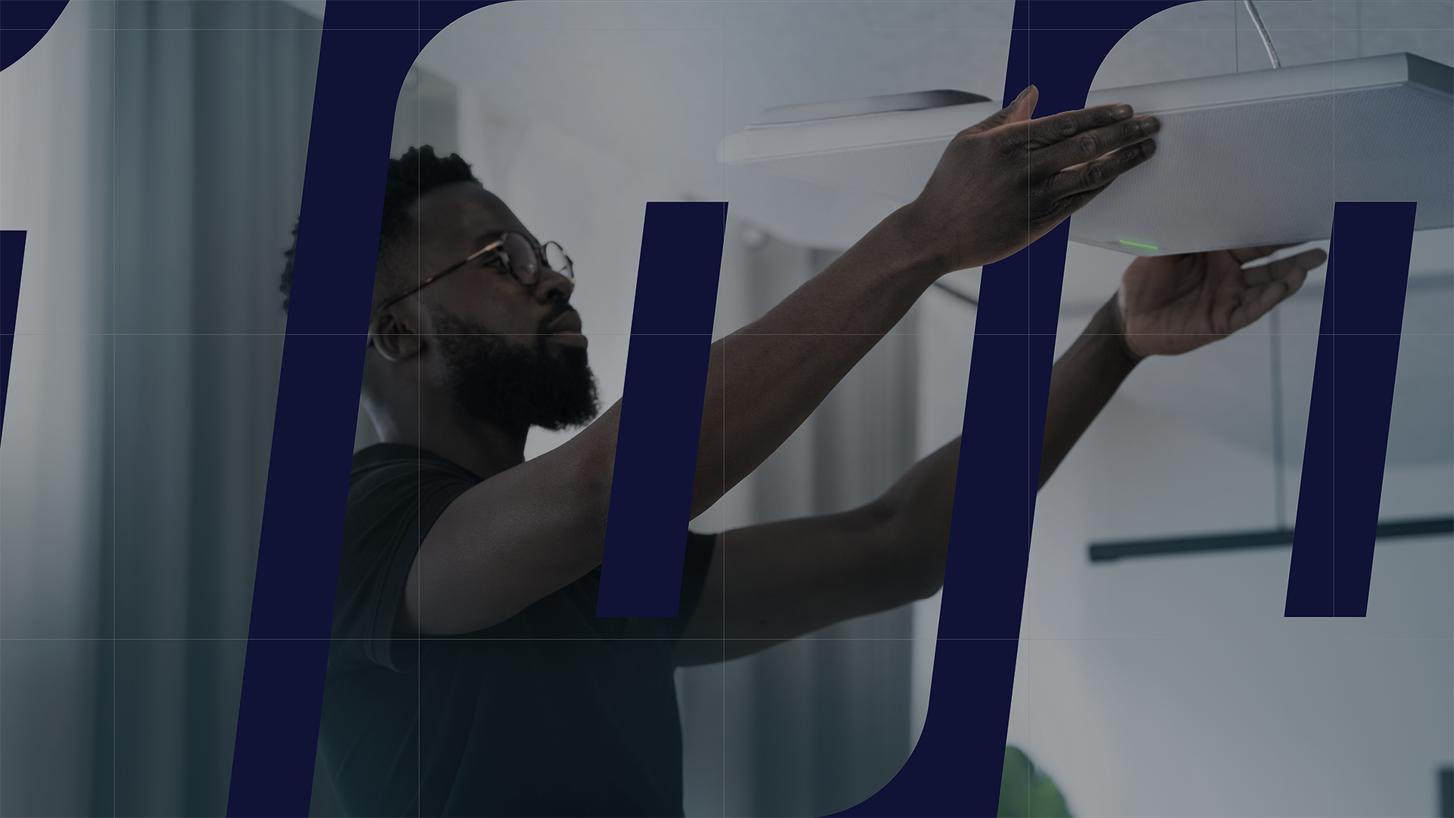
100 years of Shure: Honoring the Past, Innovating for the Future
History
Notes:
I really could talk all day about Shure's history, and it would be a lot of fun, but I’m going to briefly highlight some of the juicy bits of our 100 years in business, that I have cherry picked in order to prove my point!

Slide 3

Notes:
First of all, I am going to do my best to ruin television, you tube, all the podcasters and movies for you, because I want you to pay attention next time you see a microphone. You may not want to, but now the suggestion is there, and you will do it!!
It will almost always be a Shure mic. And once you start to notice, you will notice all the time, and you will think of me! Sorry about that! (oooh, there's the accent, sorry)
In fact, next time you message someone, look up the microphone emoji, it’s a Shure too!

Slide 4

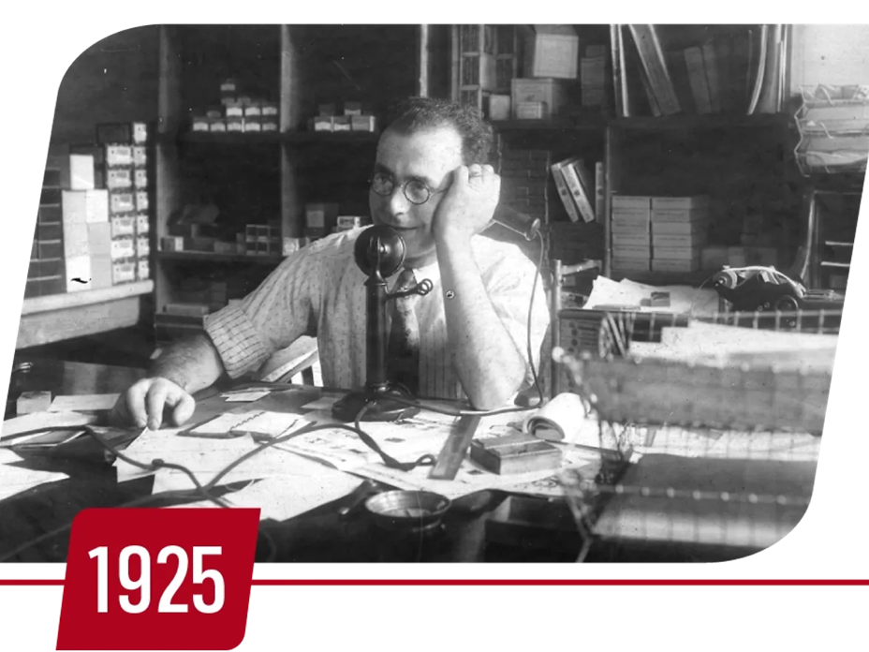
100 Years
S.N. Shure founds the Shure Radio Company in Chicago, Illinois, marking the beginning of a legacy in audio innovation.
Notes:
Sydney N. Shure founded the Shure Radio Company in Chicago Illinois, on April 25th, 1925, and started the 100 year legacy of audio innovation we are celebrating this year.

Slide 5
“We know very well that absolute perfection cannot be attained,
but we will never stop striving for it.”
—S.N. Shure
Notes:
This is truly the Shure legacy, "We know very well that absolute perfection cannot be attained, but we will never stop striving for it" Words to live by, and every year we get incrementally closer.
Let's look at some of those products you have seen from us over the years.

Slide 6
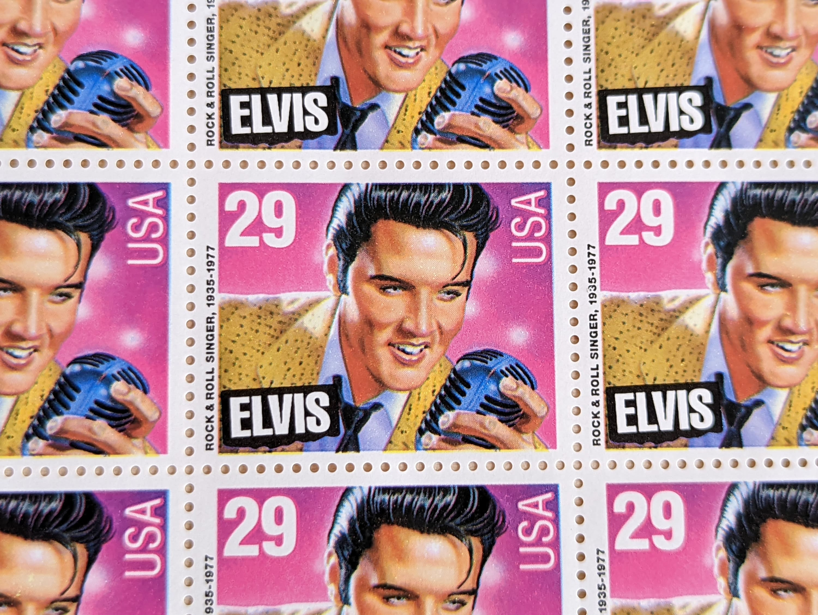
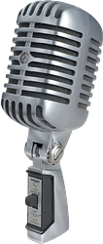
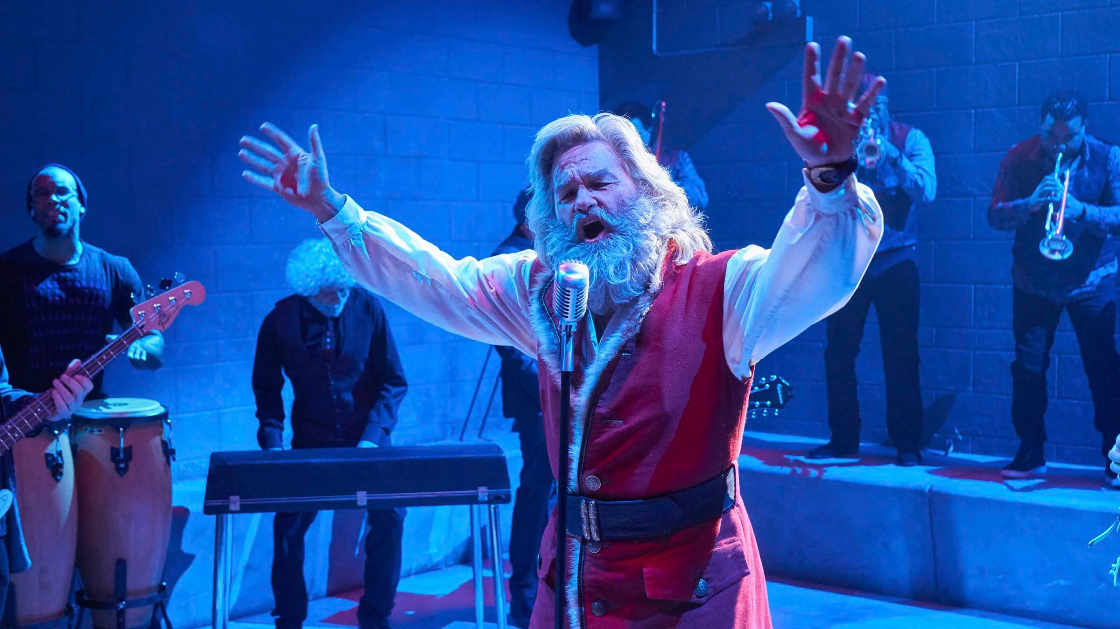
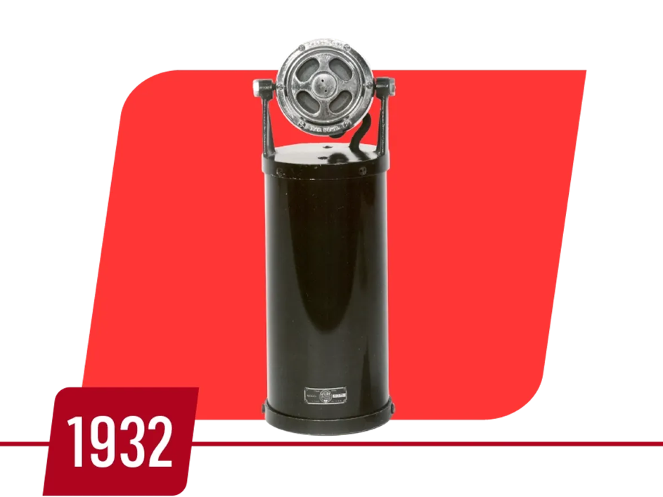


100 Years
Notes:
Shure entered the microphone market, pivoting from radios, in 1932, and then launched the Iconic Shure 55SH in 1939 (click). This is the most iconic microphone design in history. Elvis shaking his hips with one in his hand was so iconic the united states postal service put it on a stamp (click). Depending on your age, it's the "Lets get to rumble" mic that comes down on a cable in the ring. Or it's in front of your favorite sports broadcaster, Brockmire, ok, that’s my favorite broadcaster. And hey in the Santa Chronicles,(click) it's Santa's favorite mic too. I guess we are on the good list!

Slide 7
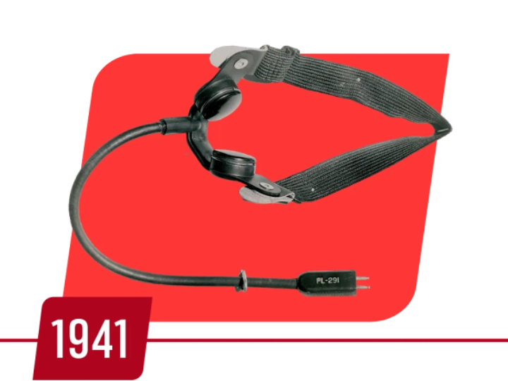
100 Years
As a leading supplier of microphones and headphones to the Allied Forces, Shure manufactures to meet the military-grade quality standards (MILSPEC) that continue to define our products today.
Notes:
Skipping forward a decade, The 2nd world war changed things again.
Shure had to scale up production, running 2 shifts a day, 6 days a week.
Shure employees who volunteered for active military duty were often turned down because Allied Forces relied heavily on devices produced at our facility in Chicago and the employees were needed more on the homefront.
Built to military grade standards that still define our products today, this lead to lower scrap rates, fewer products returned for repair and incredible product reliability.

Slide 8
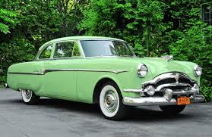
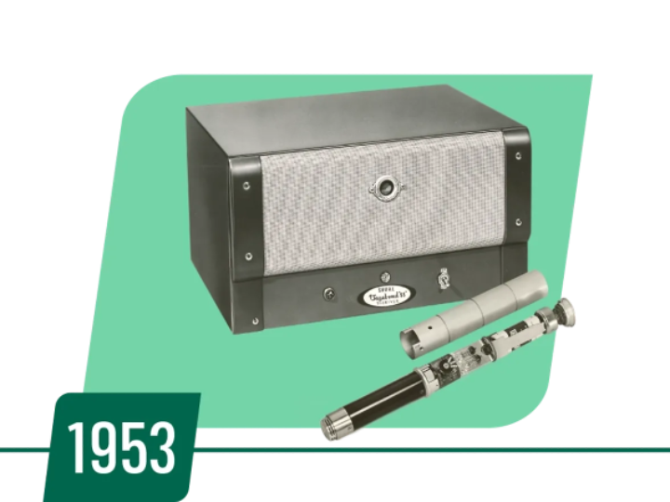
100 Years
The Vagabond 88 is the first handheld wireless microphone system for performers.
Notes:
Another decade later in 1953 we launched the first wireless handheld mic for performers. The Vagabond 88, offered 30 feet of wireless range for the low low one time fee of $700, or about eight thousand in todays currency.
Think about that for a second. In 1953 we were making wireless performance mics, Dwight D Eisenhower was president, and a new Packard Clipper cost $2,679...

Slide 9
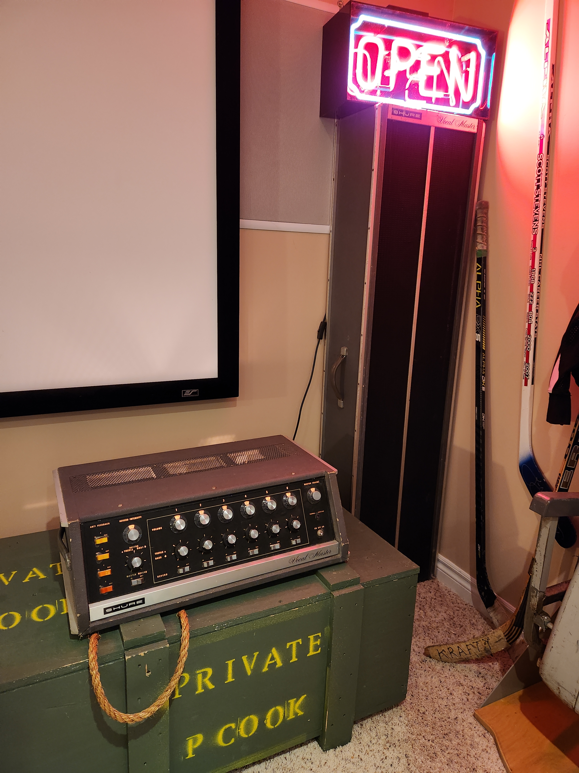
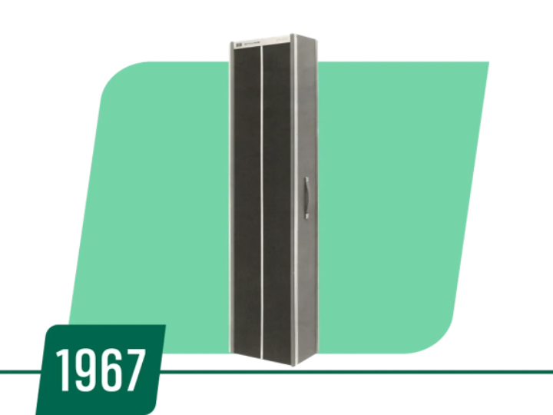
100 Years
The Vocal Master, the first portable PA system for vocals, features a six-channel mixer, power amplifier, and loudspeakers, transforming live sound reinforcement.
Notes:
Lets now jump to the 1960's,
In 1967 we launched the vocal master PA system for live sound reinforcement. A pioneer of portable PA's for performance. Yes, Shure has a long history of speakers, as proven by my basement, yes, I am still a Shure Fanboy, and my basement is open? But look at that portable amp and mixer, I can smell the tubes from here....

Slide 10
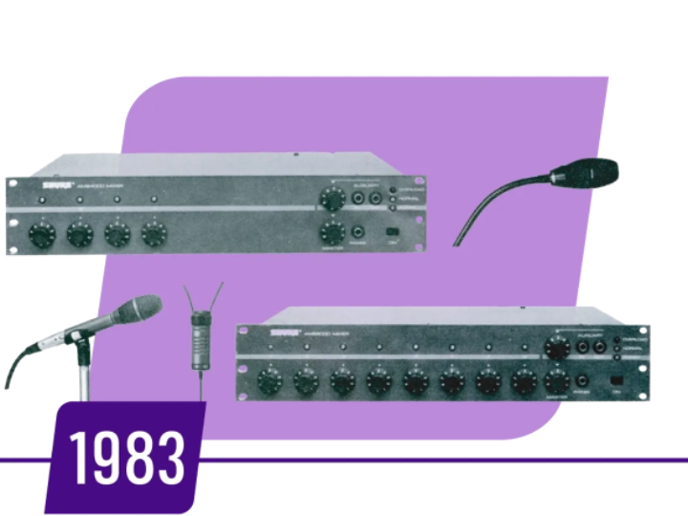
100 Years
Shure enters the conferencing market with AMS, our first automatic mixing system for corporate meeting rooms. A year later, using a microprocessor and embedded code, Shure releases the AMS880 which controls a video switcher so that camera selection follows the talker.
Notes:
Big jump into the 80's, in 1983 we entered the conferencing market with AMS, our automatic mixing system for meeting rooms. And in 1988 we are Nominated for a Technical Emmy for voice activated mixers for broadcast. Shure is there.

Slide 11
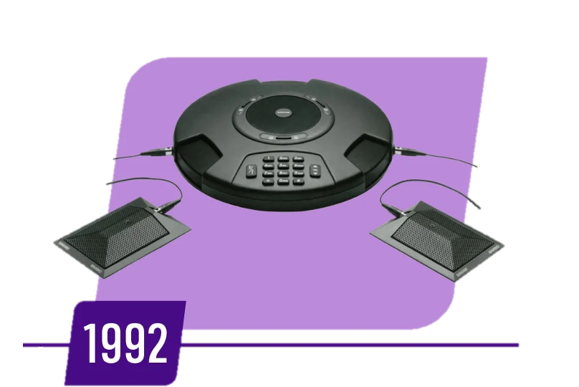
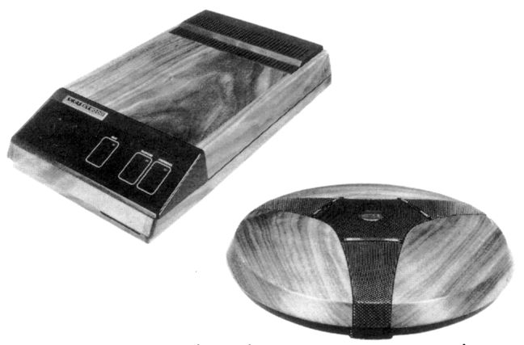
100 Years
Shure releases the ST3000 Speakerphone transforming how groups collaborate.
198
1984
Notes:
And in 1984 you start to see the shift in products towards collaboration. Gotta love a conferencing phone system made from walnut....but it was revolutionary, and "inspired" many other companies in the industry to release their own.

Slide 12
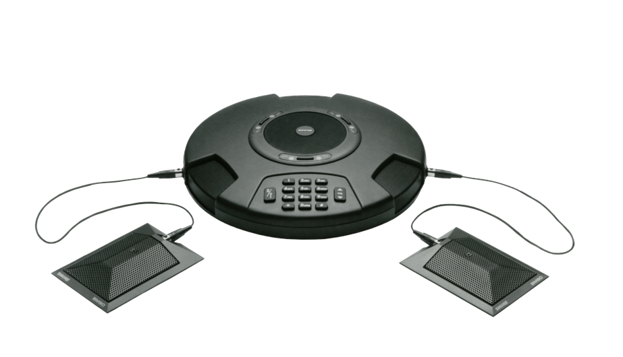
100 Years
Shure releases the ST2500 Desktop Teleconferencing Unit with DSP-based, full duplex audio.
Notes:
Fast forward a decade and look at this beauty, if you walked into a conference room in 1992 and saw the ST2500 , you knew it was serious meeting. DSP and full duplex audio.

Slide 13
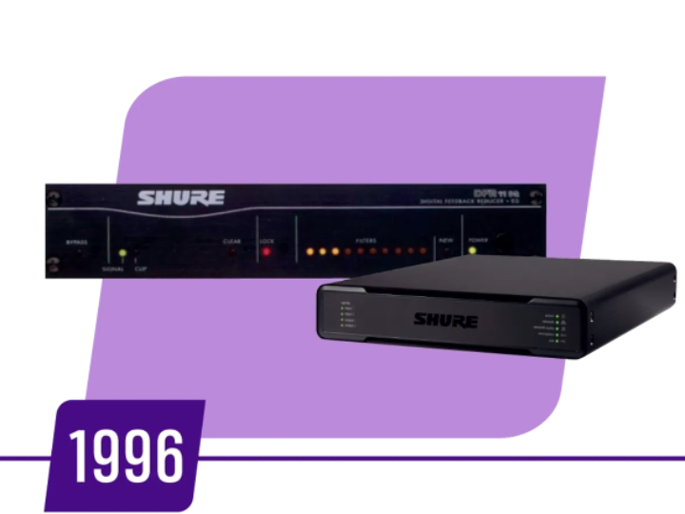
100 Years
The DFR11EQ expands Shure's use of digital signal processing via a device that sets the standard for automatic feedback reduction. Today, nearly all new Shure products are powered by DSP, and Shure continues to invest in dedicated DSP devices such as the IntelliMix® P300 Audio Conferencing Processor.
Notes:
In 1996 we pioneered Automatic feedback reduction or AEC, with the DFR11EQ, and started down a path of world class DSP.

Slide 14
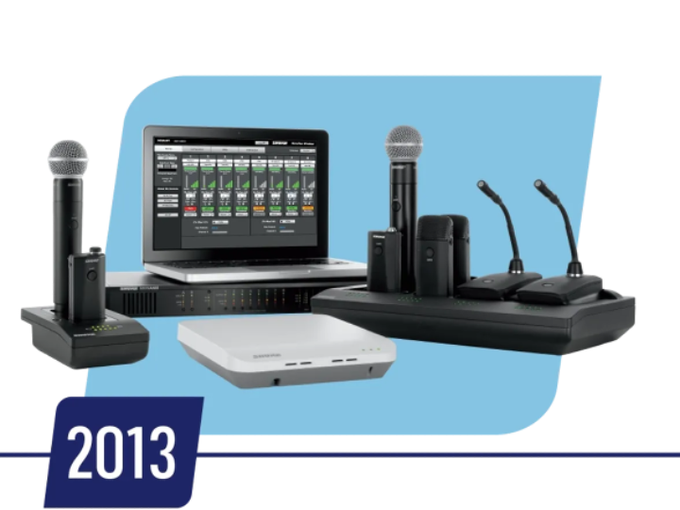
100 Years
The Microflex Wireless (MXW) System, Shure's first wireless microphone tailored for conference rooms, debuts in 2013, offering flexible and reliable audio solutions for dynamic meeting environments.
Notes:
In 2013 we launched MXW, the first wireless audio system for the conference space

Slide 15
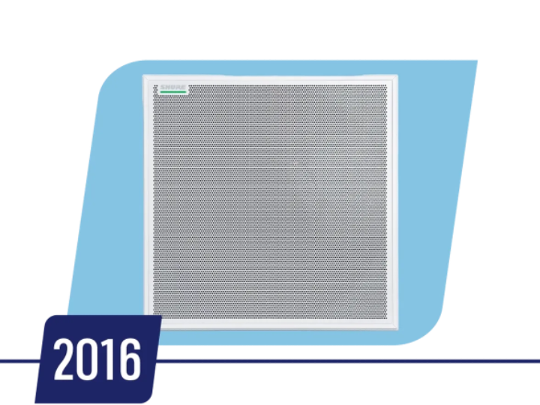
100 Years
Providing remarkable audio capture from a distance, the MXA910 Ceiling Array Microphone changes conference rooms forever.
Notes:
Then the MXA910 changed everything in 2016, a ceiling microphone with digitally steerable pick up areas, almost like flashlight mic pickup beams.... It was truly revolutionary.
For some of you not around the industry prior to the MXA910, ceiling mics weren't great, it was difficult, and Shure broke the ceiling.

Slide 16
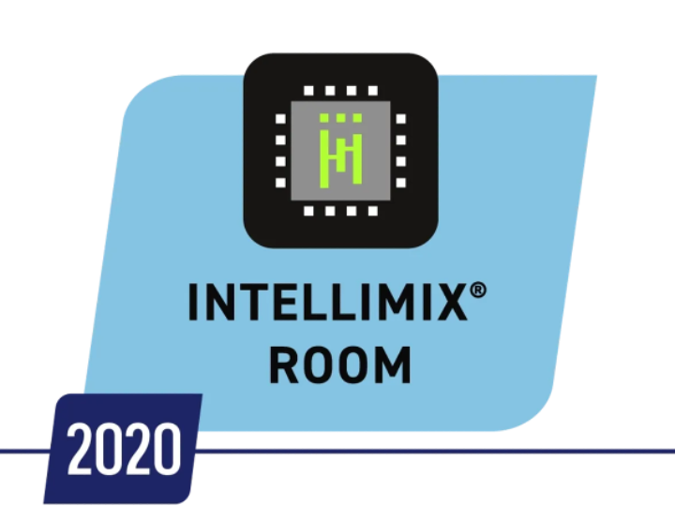

100 Years
Shure revolutionizes the AV industry with the introduction of IntelliMix Room, the first-of-its-kind audio processing software. IntelliMix Room® optimizes audio conferencing with advanced DSP algorithms that run directly on Windows devices, simplifying room deployments by eliminating the need for dedicated DSP hardware.
Notes:
Skip forward to 2020 and we launched intellimix room, a professional grade downloadable DSP for Windows.

Slide 17
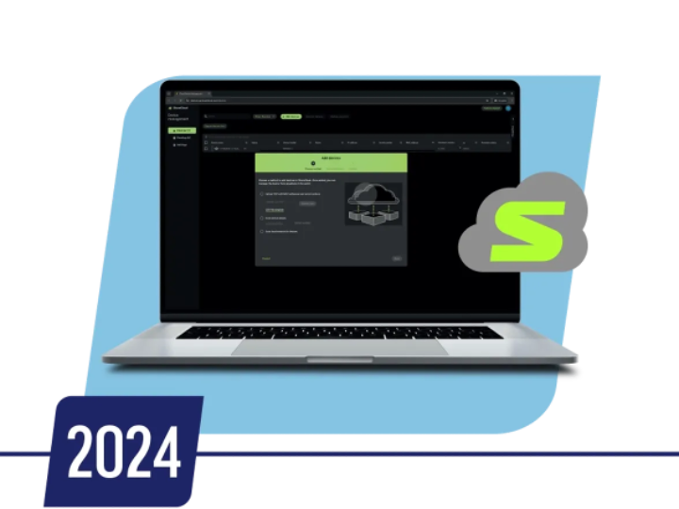

100 Years
Shure expands the Microflex Ecosystem with the addition of the MXA710 linear array, the MXA-Mute, and the MXN5 networked PoE ceiling speaker to provide a complete end-to-end audio solution.
2020
Notes:
And we keep improving, adding network mute buttons and linear array mics and speakers

Slide 18
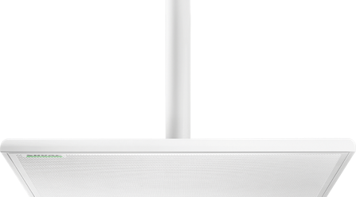
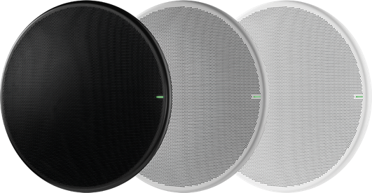
100 Years
Shure introduces the MXA920 Next Generation Array featuring Automatic Coverage™ Technology redefines streamlined setup and deployment.
2022
Notes:
In 2022 we upgraded the MXA910 to the MXA920, adding a round version as well more automatic deployment features.
We basically took our MXA910, upgraded all the features, and put in automatic transmission on it, so everyone can drive it now.

Slide 19
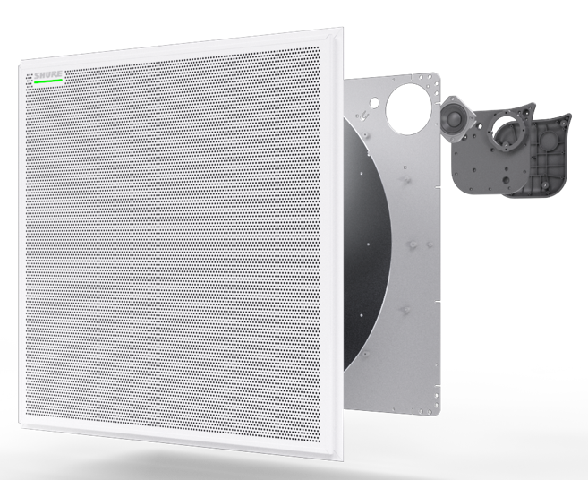
100 Years
Shure introduces the MXA902, ceiling microphone with DSP and loudspeaker for small to medium collaboration spaces.
2023
Notes:
In 2023 we launched the MXA902. The only fully integrated celling microphone and loudspeaker, the answer for small to medium rooms, it covers all talkers in a 20 x 20 area with almost no coniguration and provides far end audio through its built in loudspeaker.

Slide 20
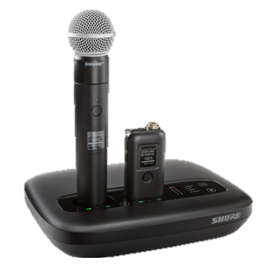
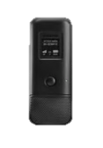
100 Years
Shure introduces the smaller-form MXA901 Ceiling Microphone Array with automatic coverage for simple deployment; and MXW neXt2 two-channel wireless microphone system.
2024
Notes:
2024 brought us the MXA901, a smaller format ceiling mic, and upgraded conference mics in the MXW NExt2 range.

Slide 21

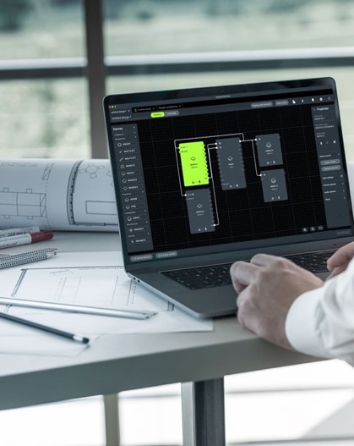
100 Years Strong
100 Years
Shure introduces the smaller-form MXA901 Ceiling Microphone Array with automatic coverage for simple deployment; and MXW neXt2 two-channel wireless microphone system.
Shure launches Designer 6 and Shure Cloud bringing simplicity to deploying, monitoring and managing Shure devices in all room sizes.
2024
Notes:
2024 also brought us Shure Cloud, our deployment and monitoring software.

Slide 22
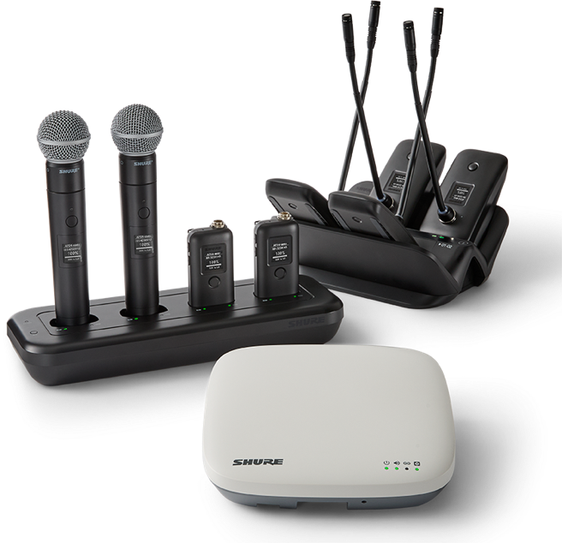
100 Years
2025
Notes:
Seeing the progression and evolution of the products is amazing.
Here is 72 years of improvement and experience in wireless audio transmission, and we can do a lot better than $8000 a channel.

Slide 23
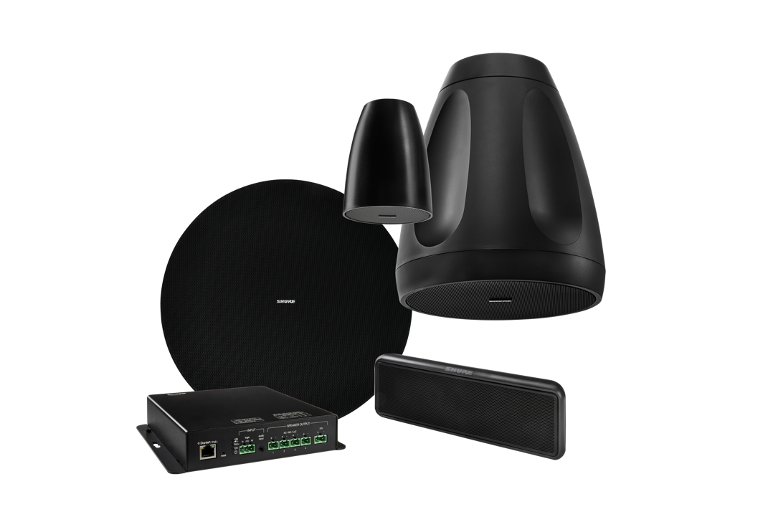
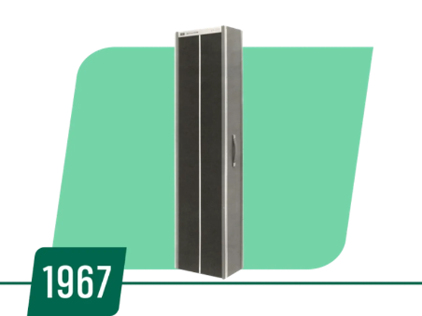
100 Years
2025
Notes:
Here's what 58 years of improvement looks like.....I couldn't even fit the picture of the old mixer in here.

Slide 24
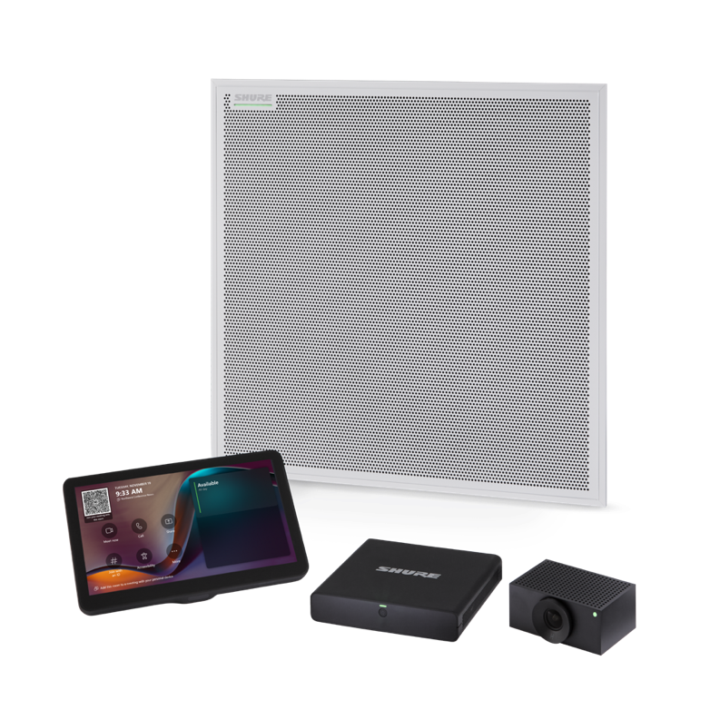
100 Years
2025
Notes:
And today we are talking about the culmination of over 33 Years of experience in conferencing, and 100 years in audio.

Slide 25



​
2025
Notes:
This year Shure entered into a partnership with Microsoft to provide high quality, easy to deploy and set up Microsoft Teams Rooms. Teams room that are intelligent enough to auto discover and set up the audio and video, a single device in the ceiling takes care of the mic and speaker in small, medium and even large or reconfigurable spaces. These Teams Rooms include DSP to remove any unwanted noise and distractions from your meetings, all in an effort to capture accurate, intelligible audio, so we can trust the transcription, summaries and action items that come from Co-pilot and other AI tools.
Shure provides 100 years of experience in making sure Co-pilot can hear you now.

Slide 26

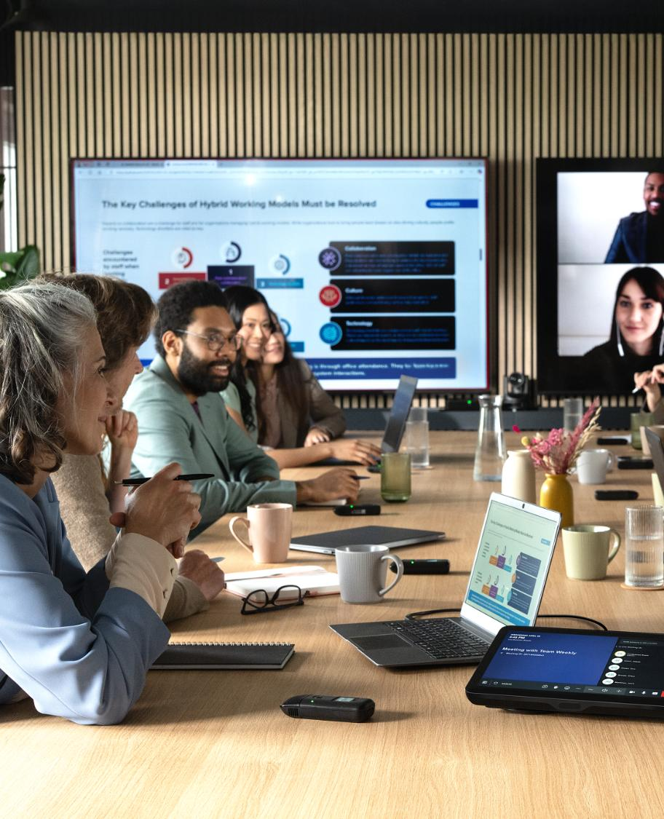
Enabling The Future
Of Collaboration
Capturing clear and precise voices is essential for modern, AI-powered meetings
High-quality audio helps convey nuances in vocal expressions and tone, bridging the gap between remote teams and fostering more efficient collaboration
Clear intelligibility ensures the accuracy of AI tools like Copilot in Microsoft Teams, incl. transcription, meeting summaries, action items and talker identification and attribution
Notes:
Capturing clear and concise speech is essential for AI driven meetings. Our high quality audio capture also conveys the sublte nuances in those voices, making collaboration feel more natural and organic. Clear intelligibility is vital to ensure the accuracy of the data being fed into your chosen AI tool, including transcription, translation, action items and so forth.

Slide 27
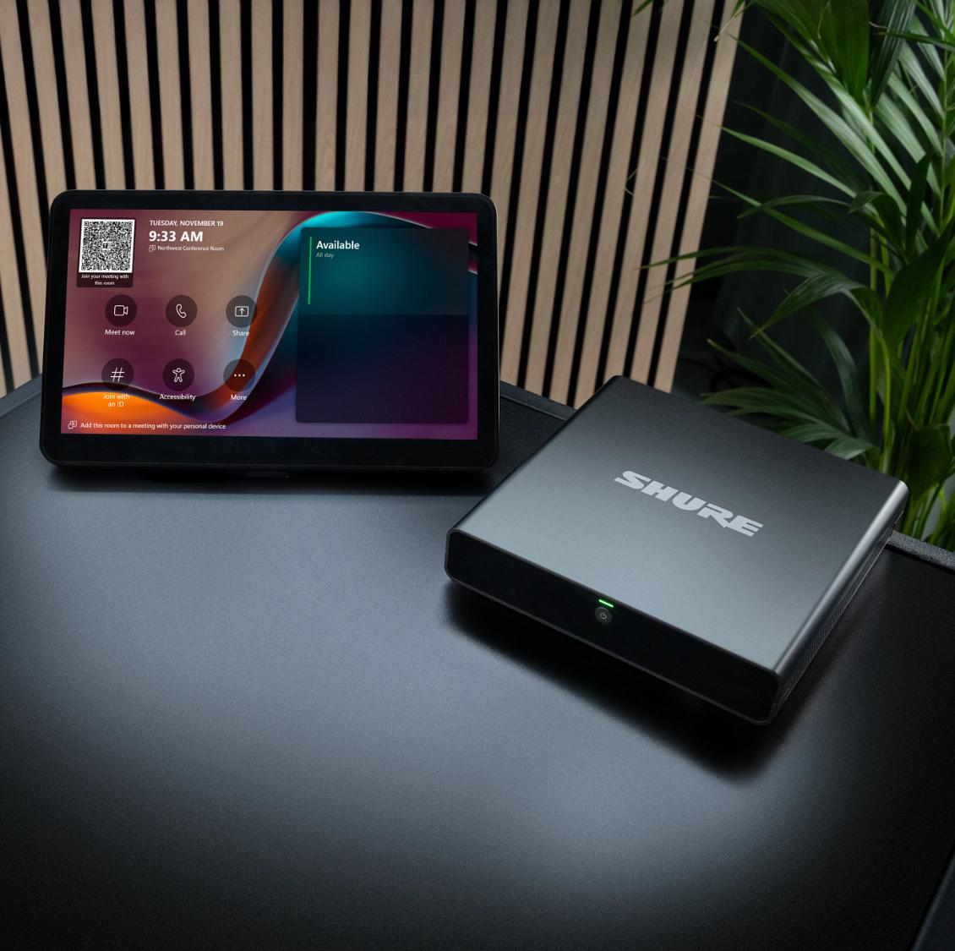

IntelliMix™ Foundation System
Base Kit or Microsoft Teams Rooms
Notes:
So this brings us to our new Intellimix Foundation System for Microsoft Teams rooms.
This certified room system provides the core components for a rich collaboration experience in Teams Room environments, offering full flexibility to design, deploy and manage sophisticated room solutions for demanding and complex spaces.

Slide 28
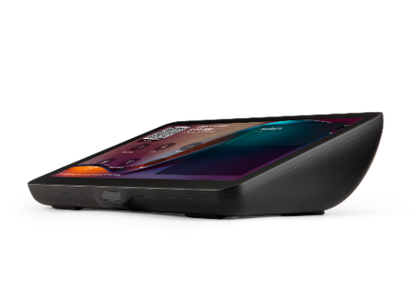
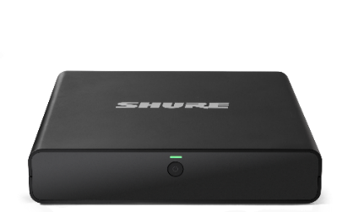
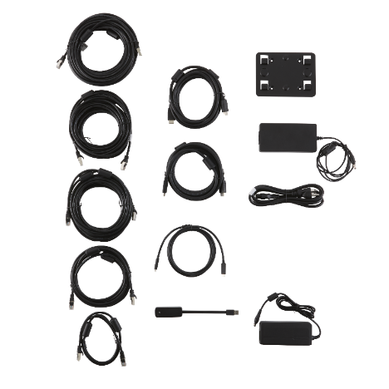
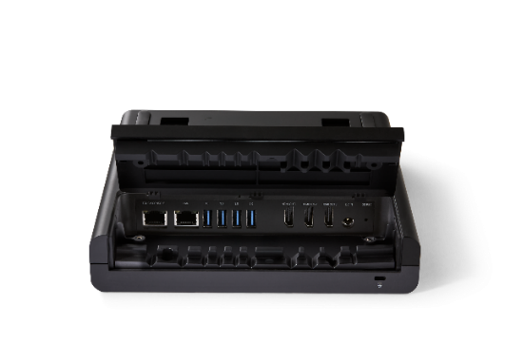
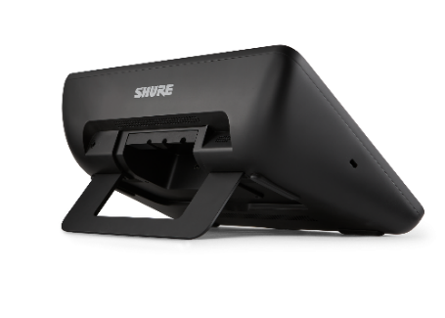
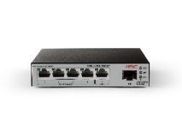

System Components
IMXCPU5
IntelliMix Foundation Compute
IMXTP11
IntelliMix Touch Panel
System Accessories
Microsoft Teams Room Compute on Windows 11 with built-in Shure IntelliMix Room DSP
11-inch Touch Panel with USB-C content ingest port and integrated kickstand
PoE+ Network Switch, cables and accessories for connectivity and power
Notes:
There are 3 components in the Foundation System, the IMX-CPU5 Intellimix Foundation Compute, the IMX-TP11 Intellimix Touch Panel, and the system accessories with a POE+ Network switch and all the cables needed for connectivity and power.

Slide 29
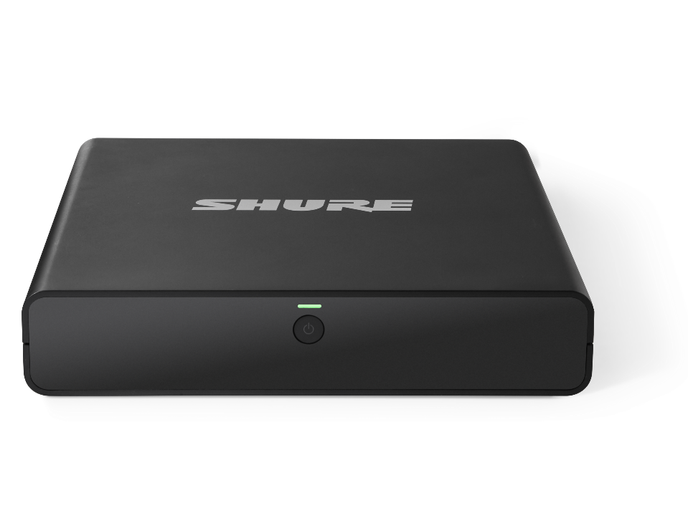




Microsoft Teams Room Compute
IMXCPU5 IntelliMix Foundation Compute
Intel 12th Gen Core i5
Windows 11 IoT Enterprise OS
Microsoft Teams Rooms Application
Supports use of Windows Autopilot with Autologin for Teams Rooms
Robust Microsoft Security Features for
Calls & Collaboration
Notes:
The IMXCPU5 Compute features a Intel 12th Generation i5 Core; running windows 11 IOT enterprise operating system; with Microsoft Teams Room Application preloaded.
As well as MSFT security framework including:
Trusted Platform Module chip (TPM 2.0) for secure encryption of credentials
Secure Boot to ensure only trusted software can be loaded
Windows Defender integration to protect against viruses and malware

Slide 30
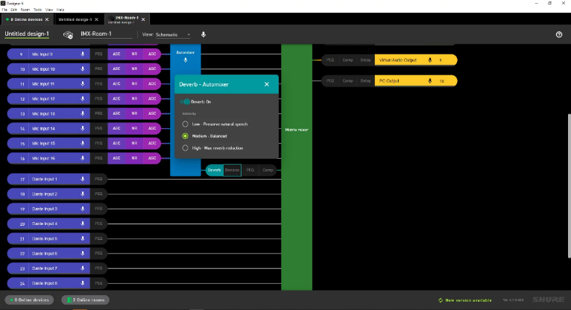
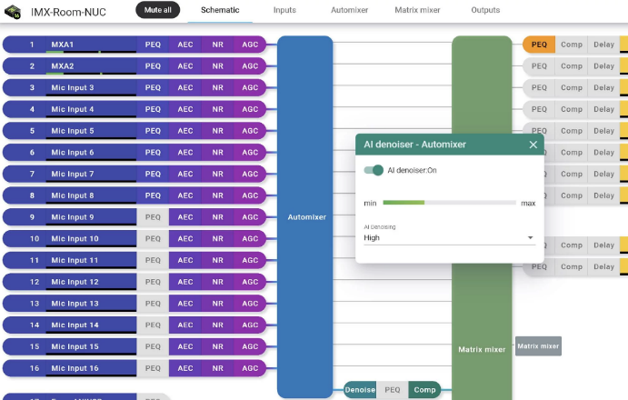
IntelliMix® Room
Audio Processing Software
License-free, 8-channel DSP built-in
Full suite of DSP functions* give you total control to customize the audio experience for each room
Integrated AI features ensure echo-, noise- and reverberation-free meeting audio, removing distracting sounds in real time and enhancing speech
Runs natively on compute with low resource utilization and removes the need for ‘specialty’ DSP hardware, reducing complexity, cost and maintenance
Shure Audio Encryption keeps meeting content secure between Shure devices (incl. compute and mics/speakers)
* DSP & AI functions include per-channel PEQ, AEC, Stereo AEC for positional / spatial audio, NR, AGC, Automatic Mixing of multiple audio channels, AI Denoiser, AI Deverb, Matrix Mixing
Notes:
Now this is where we start to separate ourselves from the rest of the pack. This is the first compute with built in DSP, further reducing hardware complexity while improving the audio quality and reliability.
There is an 8 channel, license free, Intellimix DSP built in, which includes some very cool functions like AI denoiser; that takes all the pen clicking and keyboard typing out of your meeting automatically. And AI Deverb; that can remove that echoey, cavernous sound from a really bad room.
Having flexible Dante ins and outs allows really fast and easy deployment with Shure and other third party devices, and means effortless scalability and expandability.
Also Shure Audio Encryption keeps meeting content secure between all Shure devices.

Slide 31
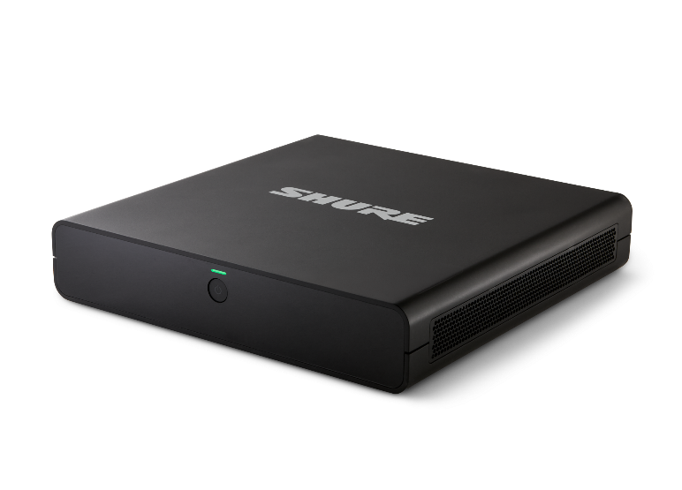
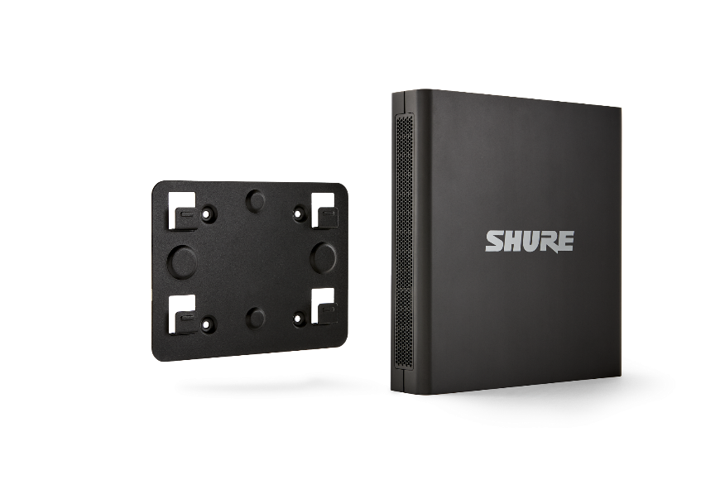
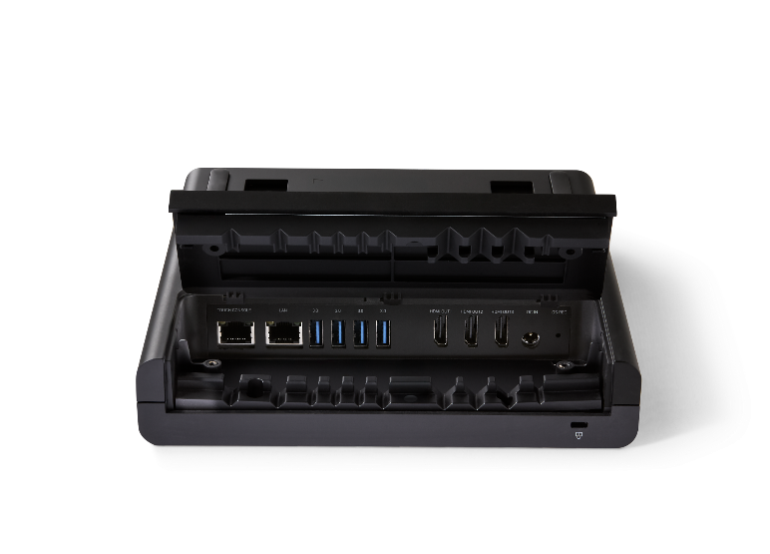
Refined Design
IMXCPU5 IntelliMix Foundation Compute
Sleek industrial design
similar to P300
Dual display output (HDMI)
Clean cable management
Wall mounting bracket included for discreet placement behind displays
Notes:
The IMXCPU5 has a minimalist design, with dual HDMI outputs and clean cable management. It also includes a wall mounting bracket so you can mount anywhere you like!

Slide 32
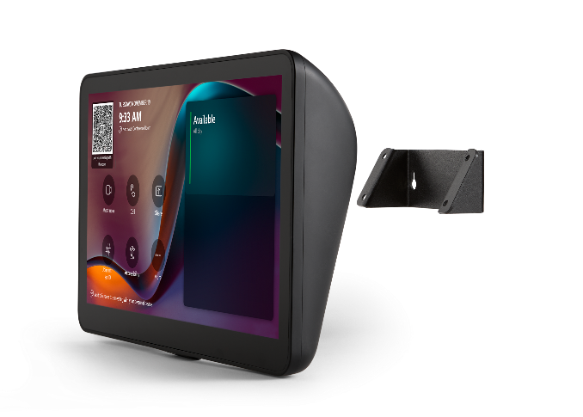

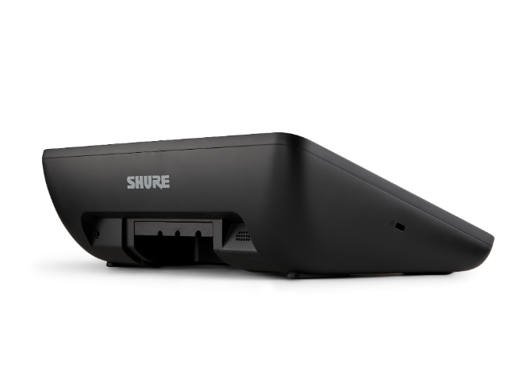
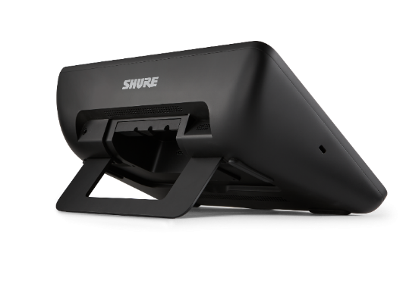
Intuitive Meeting Controls
IMXTP11 IntelliMix Touch Panel
Optional wall mounting
11-inch, high resolution display
One-touch join for Microsoft Teams Calls
PIR (passive infrared) motion sensor for auto-wake
USB-C port for content sharing and presentation
RJ45 connection for trouble-free, long-cable installations
20- or 40-degree orientation
with integrated kickstand
Notes:
The IMXTP11 Touch panel has an 11 inch high res display, features one touch join for MTR calls, and also has a passive infared sensor that will turn on the display when there is motion in the room.
The display connects to the compute via RJ45 to make long cable runs super easy, and has a USB C port for content and presentation sharing from the display.
It has a 20 or 40 degree kickstand and can also be wall mounted should you so choose!

Slide 33
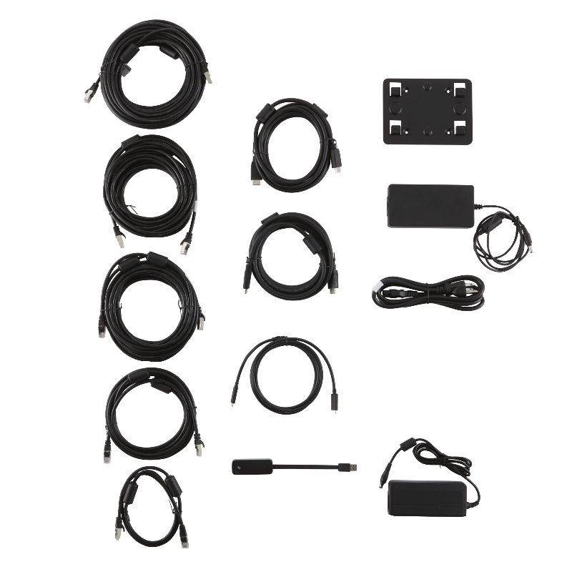
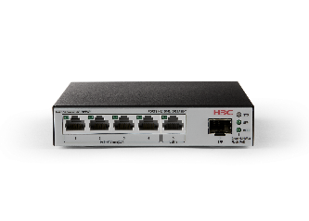
Included Accessories
Compute
Wall mounting bracket
Power cords and power supply
(vary by region)
(4) Mounting screws for wall bracket
(4) Drywall/concrete anchors
(2) 10 ft. (3 m) HDMI cables to connect displays
Networking
PoE+ network switch
Power cords and power supply
(vary by region)
USB 3.0 to Gigabit Ethernet adapter
Touch Panel
25 ft. (7.6 m) Ethernet cable
to connect to compute
6 ft. (1.8 m) USB-C cable
for in-room content sharing
Installation Cables
3 ft. (0.9 m) Ethernet cable
for USB-Ethernet adapter
10 ft. (3 m) Ethernet cable
25 ft. (7.6 m) Ethernet cable
50 ft. (15.2 m) Ethernet cable
Notes:
Also included in the package is a POE+ network switch and all the cables needed for an install in just about any size room. Including the HDMI cables for the displays, the USB-C cable for ingest and a variety of Ethernet cables.

Slide 34


Unmatched
Versatility
Optimized for use with the Microflex® Ecosystem portfolio of conferencing audio solutions certified for Microsoft Teams
Effortless integration with the most comprehensive and complete collaboration portfolio from a single vendor
Unparalleled flexibility and scalability allows to deliver custom audio solutions for rooms of all shapes and sizes
Supports third-party camera and control solutions for a complete AV system
Notes:
The compute is optimized for use with Shure's Microflex Ecosystem of conferencing solutions that are already certified for use with Microsoft Teams.
Shure now has unmatched versatility, with unparalleled flexibility and scalability, and the most complete collaboration platform from a single vendor.

Slide 35

System Example: Medium Room
Notes:
I keep saying we are flexible and scalable, so let show how.
Lets take a look at a medium sized room to start with. We have installed the Intellimix Foundation and Compute in the room, using the cables provided. We have installed an MXA901 Ceiling array microphone above the table, it will cover all talkers in the 20 x 20 foot area beneath it. We have also connected our new MXN-AMP, a POE+ powered, plenum rated network speaker amplifier. The MXN AMP is powering 2 of Shure's new MXP-3 passive speakers, mounted on the wall beside the displays. And we have put in a 3rd party camera for video.
We are ready for a meeting....it might look a little complicated, here's another view.

Slide 36











System Connection: Medium Room
‒ CAT 5/6
‒ HDMI
‒ USB
‒ Speaker
‒ Power
Power
LAN
Power
Notes:
The MXA901 and MXNAMP connected to switch, Switch and everything else connected to compute. Laptop is there to show content sharing via the USB ingest on the sreen. Nice and simple.

Slide 37

System Example: Large Room
Notes:
Now we can scale up for a larger room. Still built around our foundation system, wait, its called foundation cause it's the base? That took me way too long to put together...
Here we are using a single MXA920 ceiling array microphone covering this entire conference room. We are still also using a single MXNAMP, but now we are using that AMP to power 4 MXP5 passive ceiling speakers, another new edition to the Shure family this year.

Slide 38


System Connection: Large Room
‒ CAT 5/6
‒ HDMI
‒ USB
‒ Speaker
‒ Power
Power
LAN
Power
Notes:
And this is just how simple, an incredibly advanced system can be, when it's done using 100 years of experience.

Slide 39

System Example: Classroom
Notes:
Now lets take a look at a class room set up, this is a big classroom, so we have 2 MXA920s covering the class room and all the talkers in there, all of them, even when they wont be quiet.
We have the MXNAMP powering 4 of Shure's new MXP1 passive celling speakers - (CLICK)

Slide 40



System Connection: Classroom
‒ CAT 5/6
‒ HDMI
‒ USB
‒ Speaker
‒ Power
Power
LAN
Power
Notes:
and we have added an MXWNEXT2, 2 channel system with a handheld and bodypack for presenters. The MXNEXT2 is amazing in that the access point, dsp and charger are all built in the base, with a USB output, making it the most flexible 2 channel system on the market!

Slide 41

System Example: Flexible Room
Notes:
And here for a flexible space, we can provide a Shure solution without any ceiling array microphones, instead using our new MXW Next 4 or 8. The update to our legacy MXW range, the MXWNext offers 4 or 8 channels, and can implement body packs, hand helds, boundary mics and goosenecks. With built in DSP and unrivalled connectivity, the MXW NExt range is certainly worth the trip to our booth to check out. The legacy MXW range came out in 2013, you know what else came out it 2013? Frozen....that tells me when it comes to your old MXW system, "let it go" and check out its replacement!

Slide 42



System Connection: Classroom
‒ CAT 5/6
‒ HDMI
‒ USB
‒ Speaker
‒ Power
Wireless
Power
LAN
Power
Notes:
You'll see the transmitters in the charging base here, and might notice the new display, but what you can't see is that the hand helds have an almost 40 hour battery life...they last longer than me on a single charge.
What a great simple solution for a flexible rooms that you don't want to install anything in the ceiling, other than a couple of very small, discrete pendant speakers.

Slide 43


System Configuration
Designer 6 Software
Shorten design cycles and support early project management
Import floor plans, identify microphone positioning, room size, and ceiling height
Design accurate audio coverage before devices are installed
Add channels and manage signal routing
Model collaboration spaces and create templates for consistency
IMXF5 requires Designer 6.5 or later
Notes:
To make your installations as pain free as possible, Shure has developed Designer 6, our system configuration software.
You can add channels and manage all of your signal routes with no additional software or licenses needed.
Using Desginer 6 can shorten your design time, in that you can import your floor plans and position mics, on site, or before the mics are even installed. Then you can copy and paste those designs to other rooms.

Slide 44


Global IT Management powered by ShureCloud
Comprehensive platform to monitor, manage, update and troubleshoot Shure systems in real-time, from anywhere
Strict security controls, incl. comprehensive identity management to restrict user access
Integration capabilities with other CRM/SaaS
platforms like ServiceNow to simplify IT operations
Analytics and actionable insights to streamline
operations and make informed decisions
Supports management via Teams Admin Center and Teams Rooms Pro Management Portal
Notes:
Overseeing it all is our Global It management powered by ShureCloud.
Shure Cloud is a comprehensive, completely free software platform to monitor and manage your Shure systems in real time from anywhere with internet access.
Shure Cloud has strict security controls including ID management and USER access controls. It also integrates with other platforms like servicenow to simplify your IT operations.
Having this data will allow you to make informed decision and streamline your operations.

Slide 45


Extended Warranty
Optional 3-Year Warranty Extension offers peace of mind throughout extended depreciation and refresh cycles
Standard Shure Limited Warranty + Extended Warranty provides total coverage of up to 5 years
Covers cost of in-warranty repairs or replacement
Must be purchased from the same vendor as the hardware, within 60 days of the original sale
Please directly contact Shure Customer Service for Extended Warranty orders.
See Shure Extended Warranty B2B Terms and Conditions for details
Notes:
Shure also understands that our customers wanted a longer warranty on their investment, to ensure trouble free use for 5 years, we now offer an optional 3 year warranty extension.
This covers the cost of in warranty repairs or replacements and needs to be purchased from the same vendor as the hardware.
Nothing like peace of mind for the full life cycle of your MTRs..

Slide 46


What Makes the IntelliMix Foundation System Different?
01
100 Years of Quality & Expertise
#One
Future-proof collaboration solution from a reputable, global brand known for superior quality, performance, reliability and support, and a leading innovator with a century-long expertise in audio engineering.
Notes:
So as I come to a conclusion, I will leave you with 5 quick reasons that make the Shure Intellimix Foundation System different and better
Number 1 - Shure has 100 years of quality and expertise. Shure is simply the best at it, we are known globally for our dedication to superior quality, superior performance, unrivalled reliability, and world class support.

Slide 47

What Makes the IntelliMix Foundation System Different?
02
Comprehensive Collaboration Solutions
#Two
The IntelliMix Foundation System, paired with Microflex Ecosystem solutions certified for Microsoft Teams, provides the most complete and versatile conferencing ecosystem from a single vendor, offering unmatched versatility and scalability.
Notes:
Second!
The Shure Intellimix Foundation system, paired with other solutions from our Microflex Ecosystem of MS Teams certified microphones and speakers, provides the most versatile, scalable, advanced and intelligible conference systems available from a single vendor.

Slide 48

What Makes the IntelliMix Foundation System Different?
03
First Compute + Audio DSP
#Three
First and only Teams Room Compute with comprehensive, built-in DSP reduces the need for specialty DSP hardware, delivering premium sound quality while making installs simpler and ensuring greater system reliability.
Notes:
And 3 – The Shure Intellimix Foundation system is the first and only Teams Room compute with a built in DSP, delivering premium sound quality and will help simplify your installations.

Slide 49

What Makes the IntelliMix Foundation System Different?
04
Flexible Configuration
#Four
Dante I/Os allow to mix and match networked Shure Microflex Ecosystem and third-party camera and control solutions for effortless deployment and scaling into all room types and sizes, with expandability if room needs change
Notes:
Number 4 -
Dante ins and outs allow flexibility with the Shure Microflex Ecosystem and third-party camera and control solutions for deployment into all room types and sizes, with expandability if room needs change

Slide 50


What Makes the IntelliMix Foundation System Different?
05
Premium Global Support
#Five
Exceptional service and dedication to customer satisfaction with a global team of highly trained professionals available to support customers.
Add-on, optional extended warranty offers peace of mind and investment protection throughout extended depreciation and refresh cycles.
Notes:
And lastly, first class global support and optional extended warranty to ensure your meetings are pain free for up to five years.

Slide 51
Thank You!
Notes:
Alright folks I thank you so much for your time, please come see the great Shure folks at booth 2843 to get caught up on all of the new products Shure has to offer.
Shure was, Shure is, and Shure will be, here's the next 100 years.

Slide 52






Slide 53
APPENDIX – FAQs
Shure internal use only. Do not share with customers.

Slide 54
FAQs
FAQs as of May 20, 2025
What software versions work with IMXF5?
Designer 6.5 or later (available June 2025)
Foundation System IntelliMix Room 6.5 or later
(available June 2025)
How do I update IMXF5?
IMXF5 will NOT work with Designer 6.5 out of the box
IntelliMix Room update is necessary
Update automatically downloads from internet within 20 min of power up
The update will be deployed automatically overnight, or can be deployed manually by opening the Shure .exe update file.
Does the current version IntelliMix Room Kits work with current version of Designer?
Yes. When the auto-configuration setup runs successfully, current version of Designer works with current version of IntelliMix Room in live mode.
What is the difference between:
IMXF5 IntelliMix Foundation System and
IMXRK IntelliMix Room Kit Foundation System
It is the same item, the only difference is the successful completion of Auto-Setup when used within IntelliMix Room Kits.
What is the connection for the Designer interface to IMXF5?
The computer running Designer must connect to the PoE+ network switch connected to the provided USB-Lan adapter
Unless IntelliMix Room software is re-configured to use the Compute’s LAN port.

