Slide 2
Shaping the Future Workplace: The Role of AV in Modern Office Design
ED41
Tuesday
11:00am – 12:00pm ET
W314AB

Slide 3
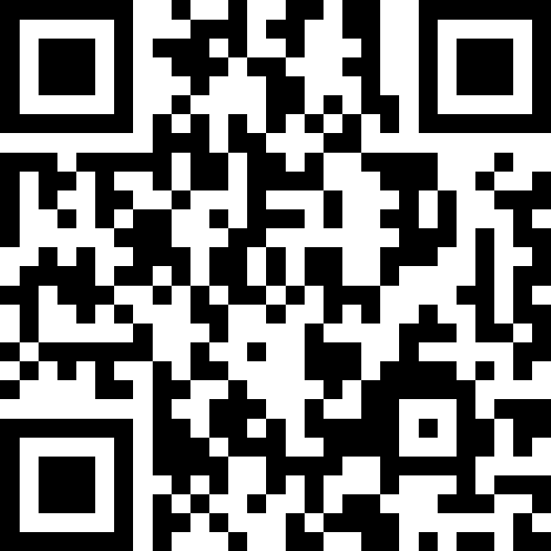
Jump into the discussion!
Q&A
- Join via QR code
Or Slido.com code 3696 706

Slide 5
If you had to eliminate one institutional darling in workplace AV design, something everyone assumes is essential but really isn’t, what would you delete and why?
code 3696 706

Slide 6
Omar Ramirez – Workshape
“Our mission is clear, getting the most out of getting together”

Slide 7
Sharath Abraham– Jabra
“You can spend big on tech, but if it’s not based on culture, it’s just expensive noise”

Slide 8
Lance McDonald – Capital Group
“This is AV’s golden moment to influence how companies think, connect, and perform”

Slide 9
Jump into the discussion!
Q&A
- Join via QR code
Or Slido.com code 3696 706

Slide 10
If you could give one bold piece of advice to someone looking to transform their workplace through, something they can start doing next week, what would it be, and why does it matter?

Slide 11
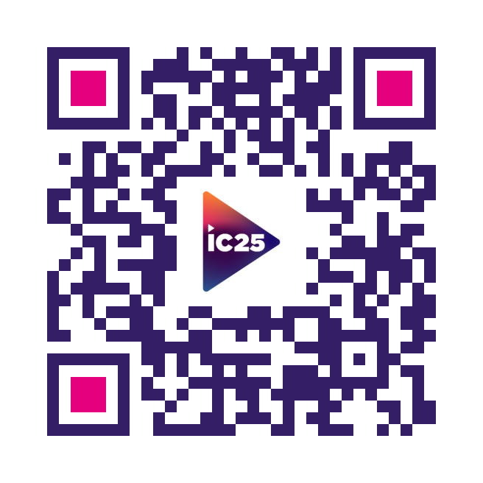
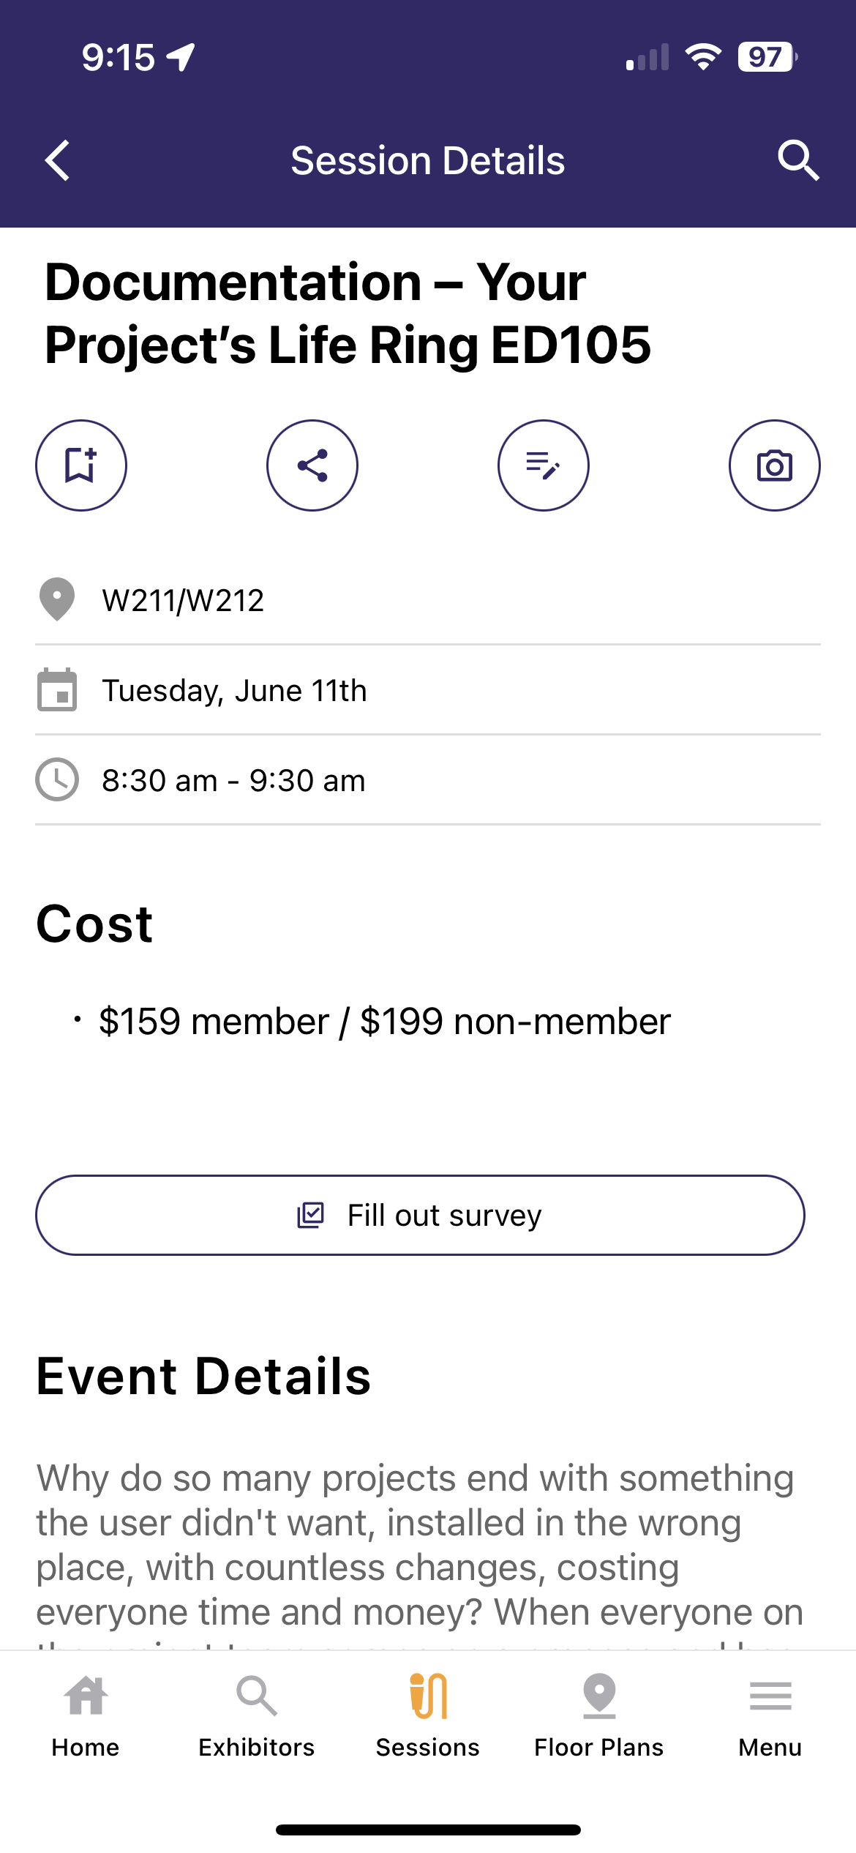
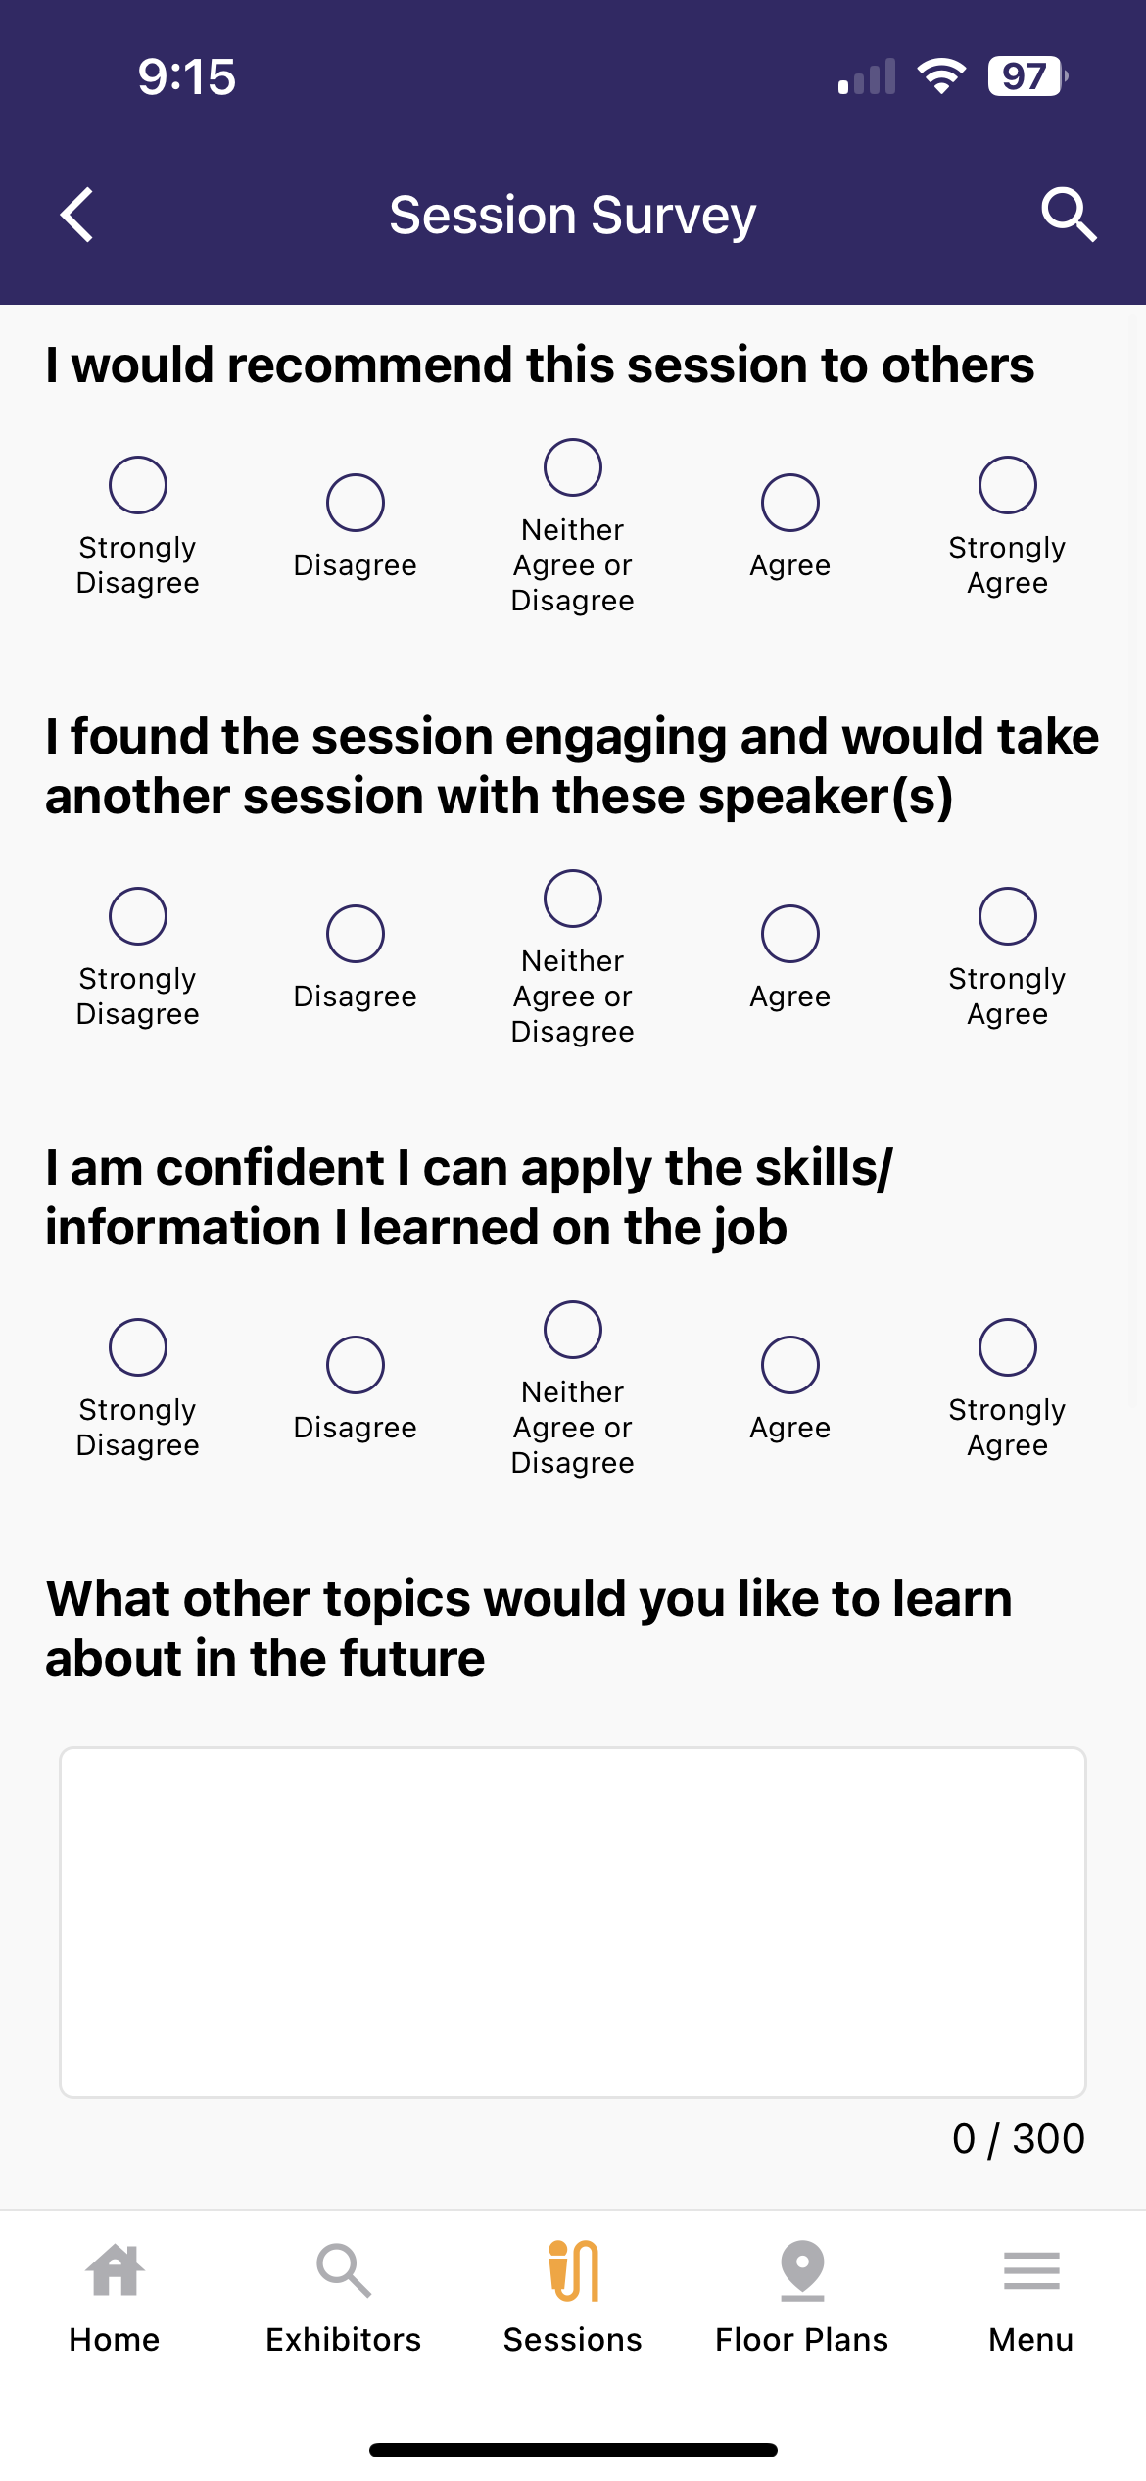
We Value Your Feedback!
Please take 2-3 minutes to complete the session feedback in our app by downloading the mobile app using the QR code!

