Slide 2
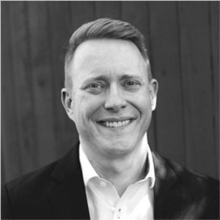
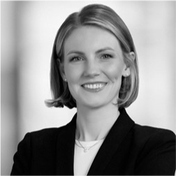
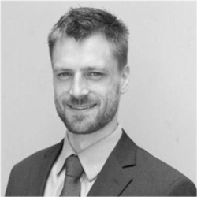
Peer-to-Peer Roundtable: Moving Your Utility
from AI Ambitions to AI Decisions
Sponsor
Speakers
Chris Richardson
Partner
Realize 2050
Mary Brown
Principal
Realize 2050
Leo Trudel
Partner
Realize 2050

Slide 3
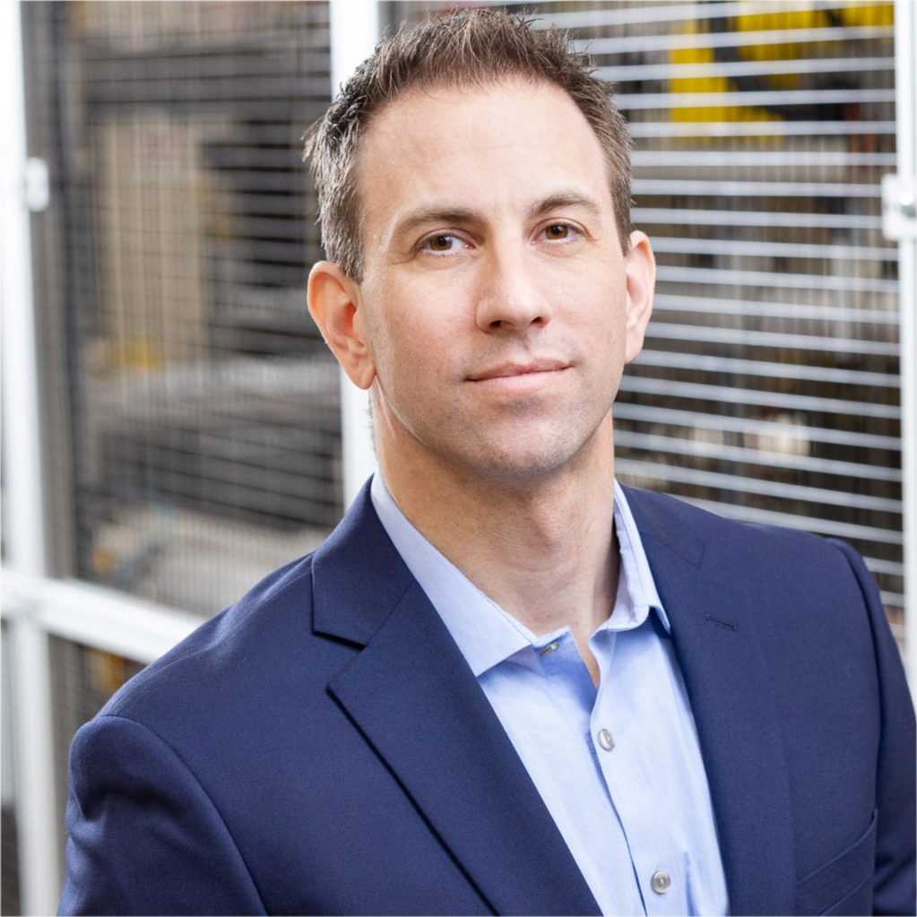
Powering the Future: Onsite Energy Solutions and
Considerations for Data Centers
Moderator
Speakers
Brad Dore
Vice President of International Marketing
EnerVenue
Tom Wilson
Principal Technical Executive
EPRI
Samaneh Morovati
Principal Engineer
Quanta Technology, LLC
David Derlin
Commercial Development Manager
PSEG
Allan Schurr
Chief Commercial Officer
Enchanted Rock

Slide 4
Managing Complexity and Reliability with Total
Grid Orchestration
Moderator
Speakers
Joe Zerdin
Director Distribution Large Customers, Sustainment, Technical Services, BAF
Hydro One
Chaitanya Baone
Head of Product
ThinkLabs
Peter Muhoro
Chief Strategy, Technology & Innovation Officer Rappahannock Electric Cooperative
Eric Gupta
Principal Consultant
Black & Veatch

Slide 5
How Utilities and Investors Can Balance AI and its Energy Use
Speaker
Pradeep Tagare
VP & the Head of Corporate Venture Fund
National Grid Partners

