Slide 1

Talk Tech to Me:
Demystifying IT Lingo for Clear Communication
Presented by Jenn Steinhardt
Design Engineer

Slide 2

Jenn Steinhardt
Design Engineer for AVI-SPL
Chair of AVIXA Diversity Council
Past lives in service, project coordination, marketing, rentals, consulting & sales
Education in Media Arts & Design and masters in Sociology
Some certifications include CTS-D, Netgear AV, Dante Level 1-3, SDVoE Design Partner
Twitter/Bluesky: NerdyGirlAV
https://www.linkedin.com/in/
jsteinhardt/

Slide 3
Learning Objectives
  Identify and define core IT and networking terms used in AV and IT environments
  Translate technical network terminology into plain language to improve communication and collaboration with IT and engineering teams.
  Recognize how foundational IT and networking concepts apply to AV system planning, deployment, and support, supporting better decision-making and cross-functional clarity.

Slide 4
Agenda For Today’s Session
The Landscape of AV over IP
Foundational IT and Networking Concepts for AV Systems
  Key Terms
    Hardware & Other Components
    Network Architecture & Typology
  Key Concepts
    Network Traffic & Segmentation
    Protocols
    Bandwidth, Latency and Compression
Applying IT Concepts to AV System Planning & Deployment
  Pre-sales and deployment readiness
  Documentation Strategies

Slide 5
The Landscape of AVoIP Compared to Traditional AV Systems
AV over IP involves the encoding, compression, and transmission of audio and video signals into data packets that traverse standard Ethernet networks, fundamentally changing how AV content is distributed and managed.
Benefits to AVoIP:
Unparalleled scalability
Centralized management
Cost efficiency, enhanced quality, and geographical flexibility.
Critical impacts if needs analysis, pre-deployment planning and coordination is not adhered to, though.

Slide 6
The Landscape of AVoIP Standards
SDVoE (Software Defined Video over Ethernet): This is a technology that leverages standard Ethernet networks to transport uncompressed video at resolutions up to 8K with near-zero latency. It requires 10Gb Ethernet or higher and offers high-quality, pixel-perfect transmission, making it suitable for demanding applications like live events, medical imaging, and command and control centers.
IPMX (Internet Protocol Media Experience): This is an open standard based on SMPTE ST 2110, aiming for interoperability in professional media over IP networks. It supports compressed and uncompressed video, audio, and control data with low latency. IPMX is geared towards broadcast and professional AV installations where standards compliance and flexibility are crucial.
NDI (Network Device Interface): This is a software-based standard developed by NewTek that allows video and audio to be transmitted over standard IP networks. It offers various encoding options, including a high-efficiency, low-bandwidth codec, making it versatile for different network conditions. NDI is widely used in live production, streaming, and video conferencing due to its ease of use and flexibility.
Dante AV: Developed by Audinate, Dante is a well-established audio networking protocol that has expanded into video transmission with Dante AV. It focuses on synchronization and ease of use for distributing audio and video over standard IP networks. Dante AV often uses visually lossless compression and is suitable for installations where integrated audio and video management is important, such as in conference rooms, education, and houses of worship.

Slide 7
Table 1: Comparison: Traditional AV vs. AV over IP (AVoIP)
Feature/Characteristic | Traditional AV | AV over IP (AVoIP)
Signal Transmission Method | Dedicated point-to-point analog/digital cables (e.g., HDMI, VGA, SDI). | Data packets over standard IP network infrastructure (Ethernet).
Cabling Requirements | Extensive, specialized cabling for each connection; often bulky. | Standardized Ethernet cabling (Cat5e/6/7, Fiber); less cabling overall.
Scalability | Limited by fixed input/output ports on matrix switchers; requires more physical hardware for expansion. | Highly scalable; easily expanded by adding new endpoints to the network.
Flexibility | Fixed routing; physical reconnections needed to change signal paths. | Flexible routing; software-defined routing allows any source to any destination.
Installation Complexity | High; complex cable runs, specialized hardware configurations. | Moderate to high; requires network expertise, but physical cabling is simpler.
Long-Term Cost | Lower initial cost, but higher long-term costs for expansion, proprietary hardware, and maintenance. | Potentially higher initial cost, but lower long-term costs due to standard equipment, easier maintenance, and flexible expansion.
Management | Often manual, device-specific; limited remote management. | Centralized, software-based management; extensive remote monitoring and control.
Security | Physical security of cables; limited digital security features. | Inherits network security measures (encryption, firewalls, access control); increased attack surface if not properly secured.
Future-Proofing | Limited; hardware-dependent, often requires full system replacement for upgrades. | High; adaptable via firmware updates and modular hardware, leveraging evolving IT standards.

Slide 8
Foundational IT and Networking Concepts for AV Systems
The successful implementation of modern AV systems, particularly those leveraging AV over IP, hinges on a robust understanding of core IT networking principles. These concepts form the backbone of reliable and high-performance AV deployments.

Slide 9
Key Terms
Hardware
Network Architecture & Typology

Slide 10
Hardware & Other Components
Node: A general term for a device on a network that can send and receive data
  This could include computers, servers, routers, switches, or even devices like printers.
  Nodes can be categorized as client, server, or peer depending on their role in the network.
Client: A specific type of node that requests and receives data from another node, usually a server.
Endpoint: Any device that connects to a network and communicates with other devices or services over that network.

Slide 11

Hardware & Other Components
Server:
  Hardware
    AV Perspective: A component that stores, manages, processes, and distributes audio and video (AV) content to other devices (clients) over a network.
    IT Perspective: A specialized computer or software system designed to provide services, data, or resources to other computers, known as clients, over a network.
  Other Common Server Types
    DNS – Domain Name Server
    DHCP Server – Dynamic Host Configuration Protocol
    API Server – Application Programming Interface

Slide 12
API Versus API Server
You cannot have a functional API without an API server. The API is the abstract set of rules, and the API server is the concrete implementation that brings those rules to life. When a developer says they are "calling an API," they are sending a request to an endpoint hosted on an API server, formatted according to the rules defined by the API specification.
Examples of API Calls:
GET – Retrieve
POST – Create
PUT – Update

Slide 13
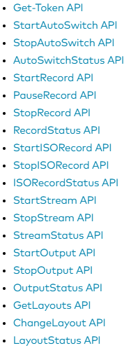
API Continued
JSON used in many web applications for exchanging data between servers and clients, as well as in APIs and configuration files.
To the right are a few examples of API’s available within a particular AV manufacturer’s API interface ->

Slide 14
Hardware & Other Components
Router: The "traffic cop" of the network.
Gateway: The gateway acts as a bridge between the local network and the internet, routing data packets to and from the update server.
Edge Device: A device or software that acts as an entry and exit point between two or more networks, and can include routers, switches, firewalls, and specialized sensors or devices that connect to a network.

Slide 15
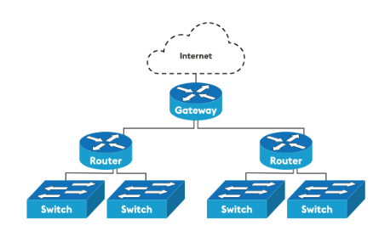

Slide 16
Hardware & Other Components
Switch: Connecting devices within a local network.
  Unmanaged & Managed
    Unmanaged switches connected directly to devices, storing the MAC address (Layer 2)
    Managed ideal for AVoIP and often required for configuring VLANS, QoS, enabling Jumbo Frames and monitoring
      Fully layer 3 capable
  LAG (or Link Aggregation Group)
    Link aggregation allows the switch to treat multiple physical links between two end-points as a single logical link. It is recommended in AVoIP systems over stacking, which which essentially daisy chains switches.
  Avoid “green” switcher that go into sleep mode which can cause delays in a system starting up or issues in the AV transmission
  Fully non-blocking

Slide 17
Hardware & Other Components
Firewall: Network security and protection.
Port Numbers: Identifies a specific process or service running on a computer, enabling communication between applications over a network. They are like "doors" on a computer, allowing incoming and outgoing data to reach the correct application. Port numbers range from 0 to 65535.
IP Address: The digital address of a device.
MAC Address: The physical address of a device.

Slide 18
Network Architecture
LAN (Local Area Network): Your local network. Most LANs use copper network connections, which limit the range of service.
  Virtual (VLAN)
WAN (Wide Area Network): Connecting networks over a larger area (like the internet).
CAN (Campus Area Network): Connecting network links across a group of buildings within an organization

Slide 19
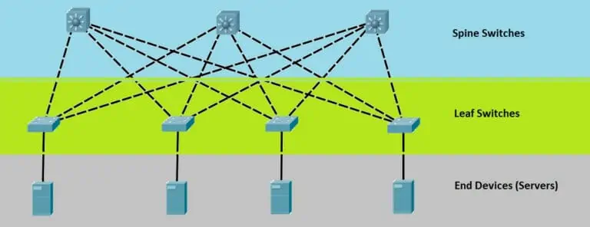
Common Network Architecture & Typology
Segmentation:
  Isolated AV
  Client Network
  Hybrid
Typologies:
  Star – devices connect to a central network switch
  Spine & Leaf – Layer 3, Spine switches are fully meshed with the layer 2 leaf switches. This typology is ideal for managing redundancy, latency and bandwidth.

Slide 20
Why AV Devices May Need Internet Access:
Firmware Updates and Management: Internet connectivity allows manufacturers to easily provide firmware updates, ensuring the device has the latest features and security patches.
AV over IP Functionality: In AVoIP systems, the internet or a local area network (LAN) is the conduit for transmitting audio and video signals as data packets.
Streaming Services: Devices like smart TVs, streaming boxes, and AV receivers need internet access to stream content from services like Netflix, YouTube, Spotify, etc.
Remote Management and Control: Internet connectivity allows for centralized management and control of the entire AV system from a single interface, simplifying operation and troubleshooting.
Enhanced Collaboration: Networked AV systems enable real-time collaboration, allowing multiple users to share content, video conference, and interact with the same display or video wall.
Integration with IoT: Internet access is crucial for the integration of AV systems with Internet of Things (IoT) devices, enabling automated functions and enhanced user experiences, such as controlling lighting, sound, or even building security systems through voice commands or app control.
Cloud-based Services: Some AV applications and services may utilize cloud-based platforms for storage, processing, or management, requiring internet access for seamless operation.

Slide 21
Key Concepts
Network Traffic & Segmentation
Protocols
Bandwidth, Latency & Compression

Slide 22
Foundational Concepts for AV Professionals – Network Traffic & Segmentation
IP Addressing & Classes
  Static, DHCP and Reserved DHCP
  Unicast, Multicast and Broadcast
    IGMP (Snooping, Querier, PIM)
Quality of Service (QOS) – Priority Delivery
  Signs QoS configuration is affecting the AV System:
    Packet Loss
    Jitter
    Latency
    Bandwidth
Subnetting/VLAN
  What needs to go on client network?
    How will updates be applied?
    Does it need to connect to the internet?
    Guest Access & Content Share
  Traffic isolation
    Example 1 – Segmenting From Client Network
    Example 2 – Segmenting AV traffic: VLANS for video, audio, control signals
    Example 3 – Segmenting AV Systems: production, Dante audio, Green-Go comms

Slide 23
Foundational Concepts for AV Professionals – Common Protocols
Protocols
  Transport Protocols
    TCP, UDP, Ethernet
    RTP – Real-time transport protocol is a network protocol based on UDP protocol that’s designed to ensure consistent and timely delivery of live media streams, making it ideal for applications like VoIP, video conferencing, and streaming.
    SRT – Secure Reliable Transport is an open-source, UDP-based protocol designed for low-latency, reliable video streaming across unpredictable networks.
  Real-time Media Protocol (RTMP)
    Common for video streaming, such as taking video from an encoder or software (like OBS) to stream out to a platform like YouTube Live, Facebook Live or Twitch
  Synchronization Protocols
    NTP Vs PTP Vs Sneakernet

Slide 24
Foundational Concepts for AV Professionals – Common Protocols
Protocols
  Transport Protocols
    TCP, UDP, Ethernet
    RTP – Real-time transport protocol is a network protocol based on UDP protocol that’s designed to ensure consistent and timely delivery of live media streams, making it ideal for applications like VoIP, video conferencing, and streaming.
    SRT – Secure Reliable Transport is an open-source, UDP-based protocol designed for low-latency, reliable video streaming across unpredictable networks.
  Real-time Media Protocol (RTMP)
    Common for video streaming, such as taking video from an encoder or software (like OBS) to stream out to a platform like YouTube Live, Facebook Live or Twitch
  Synchronization Protocols
    NTP Vs PTP Vs Sneakernet

Slide 25
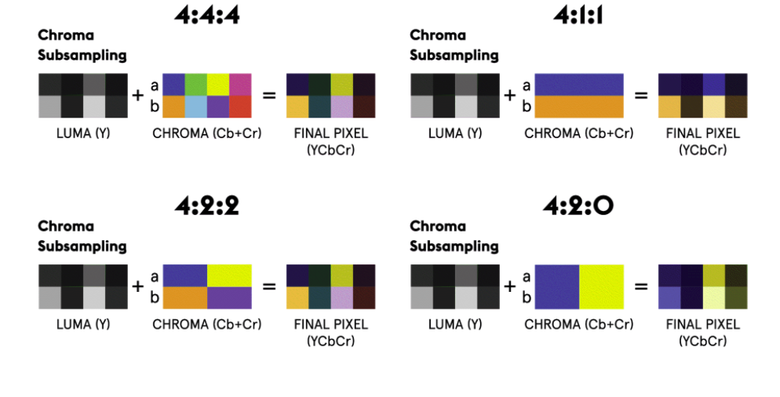
Foundational Concepts for AV Professionals – Bandwidth, Image Quality & Latency
The Relationship between Image Quality, Bandwidth & Latency
  Image Quality - The more information you can transport, the higher the image quality but also the higher the bandwidth of the signal.
    Chroma Subsampling – Luminance : Blue-Green Spectrum : Red-Green Spectrum
    Resolution (HD, 4K, 8K)
    Frame Rate
    Bit Depth
    Compression

Slide 26
Compression - Reducing the bandwidth of a signal (or the size of a file) while trying to maintain its essential characteristics.
Lossless (No info lost)
Lossy (Some info dropped)
SDVoE's proprietary Blue River NT
JPEG-XS (used by broadcast industry)
JPEG-2000
VC-2
Examples of visually lossless codecs:
H264 (Advanced Video Coding)
H265 (High Efficiency Video Coding)
AV-1 (formerly VP-9—the codec Youtube uses)

Slide 27
Table 2: Impact of Bandwidth on Audiovisual Systems
Area of Impact | Effect
Video Quality | Pixelation and blurriness: The image appears blocky or unclear. Buffering and stuttering: The video pauses frequently to load more data. Reduced clarity and detail: Fine details are lost. Distorted colors and contrast.
Image Quality & Requirements | Uncompressed AV over IP: Transmitting uncompressed 4K video can require 10 Gbps or more, necessitating robust network infrastructure. Compressed AV over IP: While compression reduces bandwidth requirements (allowing 1 Gbps networks to be used for many applications), there's a trade-off with potential quality loss and increased latency, depending on the compression method. Scalability and Flexibility: Adequate bandwidth ensures that these scalable and flexible network-based systems can deliver the desired performance across many endpoints.

Slide 28
Table 2: Impact of Bandwidth on Audiovisual Systems
Area of Impact | Effect
Audio Quality | Dropouts: Sections of audio are missing. Distorted or unclear sound: Audio can become garbled or muffled. Lag: Audio and video can become out of sync.
Real-time Communication (e.g., Video Conferencing) | Delays (latency): A noticeable lag between when something is said or done and when it's seen or heard. Choppy playback: Video and audio are not smooth. Dropped calls or disconnections.
System Performance and Reliability | Beyond just quality, sufficient bandwidth contributes to the overall stability and reliability of an AV system. Network monitoring tools often track bandwidth usage to prevent overloads that can cause devices to go offline or experience significant performance degradation.

Slide 29
Applying IT Concepts to AV System Planning
Effective AV system planning necessitates a profound integration of IT principles from the outset. This includes strategic alignment between AV and IT teams, ensuring that both system requirements and network infrastructure are clearly defined.

Slide 30
Table 3: Key IT/Networking Concepts and Their Direct Application in AV Systems
IT/Networking Concept | Core IT Definition | Direct AV Application | Why it Matters for AV
Bandwidth | Maximum data transfer rate over a network link. | Determines supported video resolution (e.g., 4K, HD) and number of simultaneous streams. | Directly impacts the image quality, reliability, and performance of both audio and video signals.
Latency | Delay in data transmission from source to destination. | Critical for real-time applications like video conferencing, live events, or interactive displays. | Minimizes noticeable delays, ensuring synchronized audio/video and responsive user interaction.
VLANs (Virtual Local Area Networks) | Logical segmentation of a network into smaller broadcast domains. | Isolates AV traffic from general IT traffic, creating dedicated pathways for sensitive AV signals. | Improves security, reduces network congestion, prevents broadcast storms, and simplifies management of AV devices.
Quality of Service (QoS) | Mechanisms to prioritize certain types of network traffic over others. | Prioritizes real-time audio and video packets to ensure consistent quality and low latency. | Prevents degradation of AV performance during network congestion, ensuring smooth and reliable operation.
Multicast | Sending data packets from a single source to a group of multiple destinations simultaneously. | Efficiently distributes AV streams (e.g., video feeds, Dante audio) to multiple displays or speakers. | Reduces network load compared to multiple unicast streams, essential for large-scale AV deployments.
IP Addressing | Numerical label assigned to each device connected to a computer network that uses the Internet Protocol for communication. | Enables unique identification and communication between all networked AV devices. | Allows for remote control, monitoring, and routing of AV signals across the network.
Security Protocols | Rules and procedures for securing data transmission and access on a network. | Encrypts AV content, authenticates devices (e.g., 802.1x), and controls access to AV systems. | Protects sensitive content, prevents unauthorized access, and maintains system integrity.
Network Topology | Physical and logical arrangement of nodes on a network. | Influences network resilience, ease of troubleshooting, and scalability of the AV system. | Dictates how AV devices are interconnected, impacting system reliability and future expansion capabilities.

Slide 31
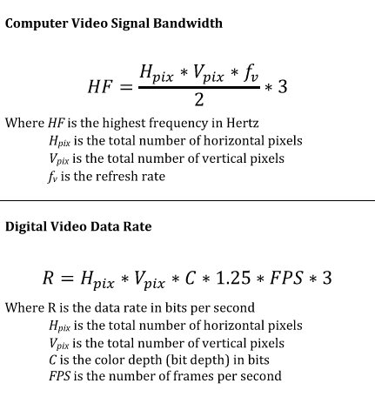
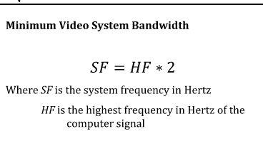
Pre-Sales Readiness
In the design phase calculate and coordinate carefully!
System Bandwidth Requirements
  Computer Signal Per Device
  Video Signal Bandwidth Per Device
  Audio Signal Bandwidth
POE Budget
Total Port Count
Total System Latency

Slide 32
Pre-Deployment Readiness
Staging in advance of deployment minimizes risks associated with on-site conditions, such as restricted firewall settings, slow internet connections, or last-minute network changes, which can significantly slow progress and introduce new variables.
  Pre-configure devices in-house
  Load firmware
  Apply security patches
  Update Software

Slide 33
Documentation Strategies for Coordination
Program Report (AKA AV Narrative, Discovery Phase Reprot, Return Brief, Concept Design Report)
  ANSI/INFOCOMM 2M-2010: “This document describes the client’s specific needs, system purpose and functionality, and the designer’s best estimate of probably cost, in a non-technical format for review and approval by the owner.”
    Executive Summary
    Space Planning
    Systems Descriptions
      What needs to connect to the AV VLAN or Client Network
    Infrastructure Considerations
    Audiovisual budgets

Slide 34
Documentation Strategies for Coordination
Device Narrative: Often produced for client when a new device is being vetted to go on the network
  Strategic Alignment & Business Value
  Network & Infrastructure Impact
  Security & Compliance
  Operations & Management
  Risk Management

Slide 35
Concepts to Coordinate Vetting Devices: Performance & Impact
Vulnerabilities and Exploits: Does the device have known security vulnerabilities, and how quickly does the vendor release patches and updates?
Authentication and Authorization: How does the device authenticate to the network? Does it support strong authentication methods (e.g., 802.1X)? Can user access be properly controlled and logged?
Encryption: Does the device encrypt its communications (audio, video, control signals) both in transit and at rest?
Firewall Compatibility: Will the device's communication ports and protocols be compatible with existing firewall policies, and will any necessary firewall rules introduce security risks?
Network Segmentation: Can the device be placed on a segmented network or VLAN to isolate it from critical business systems in case of a compromise?
Default Credentials: Does the device ship with easily guessable default usernames and passwords that need to be changed immediately?
Regular Updates: How easy is it to keep the device's firmware and software updated with the latest security patches?
Logging and Auditing: Does the device provide adequate logging capabilities for security monitoring and incident response?

Slide 36
Concepts to Coordinate Vetting Devices: Security
Bandwidth Requirements: Can the existing network infrastructure handle the device's video and audio streams without causing congestion, latency, or packet loss for other network traffic? Videoconferencing is highly sensitive to these issues.
Latency and Jitter: How much delay and variation in delay will the device introduce? High latency or jitter can lead to choppy video, audio sync issues, and generally poor meeting experiences.
Network Congestion: Will the new device exacerbate existing network congestion or introduce new bottlenecks?
Quality of Service (QoS): Does the device support QoS mechanisms (e.g., DSCP tagging) to prioritize videoconferencing traffic over less time-sensitive data? IT will want to ensure proper QoS configuration.
Wired vs. Wireless: Is it a wired or wireless device? If wireless, IT will consider Wi-Fi signal strength, potential interference, and the impact on overall wireless network performance. Wired connections are generally preferred for videoconferencing due to their stability.
Network Hardware Compatibility: Is the device compatible with existing routers, switches, firewalls, and other network infrastructure?

Slide 37
Concepts to Coordinate Vetting Devices: Management
Compatibility with Existing Ecosystem: Will the device integrate seamlessly with existing videoconferencing platforms (e.g., Zoom, Microsoft Teams, Google Meet), calendaring systems, and other collaboration tools?
Management and Monitoring: How will IT manage and monitor the device remotely? Does it support centralized management tools? Can it be easily provisioned and de-provisioned?
Remote Access and Support: How can IT troubleshoot and support the device remotely?
User Experience: Is the device easy for end-users to operate, minimizing support calls to IT?
API and Automation: Does the device offer APIs for integration with other IT systems or for automation of tasks?
Updates and Maintenance: How are firmware updates handled? Is there a clear process for maintenance and troubleshooting?

Slide 38
Documentation Strategies for Coordination
Device ID Sheet or IP Sheet
  Room Number & Name
  Manufacture name
  Product name / Model #
  Software version
  Host name
  Firmware version
  MAC Address
  IP Address (Include Vlan or subnet if not apparent)
  Configuration (Static, DHCP, DHCP with reservation)
  Physical location
  DNS, Port & Protocol Info
  QoS tags

Slide 39
Documentation Strategies for Coordination
Drawings
  Topology reveals how many devise data has to pass through before it gets to its destination.
  Assists with illustrating which devices and connection have to handle the most data
  Physical Typology vs. Logical Typology

Slide 40
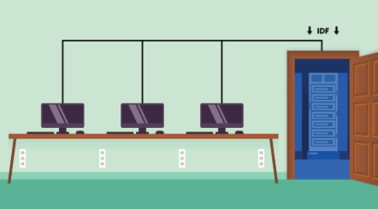
Network Typology Drawings
Physical: physical arrangement of devices, cabling, and other equipment on a network. In other words, it's how a network has been wired or physically connected.

Slide 41
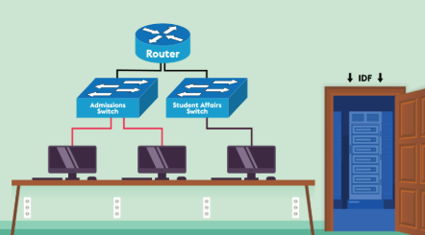
Network Typology Drawings
Logical: physical layout of devices and cables, describing how data flows within the network and the logical connections between devices.

Slide 42
Continued Learning Resources
AVIXA Standards –
  https://www.avixa.org/standards/current-standards
Foundations to AVOIP
Manufacturer Training

