Slide 1


Slide 2


Utility University UU203
2
IEEE 1815 (DNP3) — Part 1, Fundamentals
Presented by:
Andrew West, Chair, DNP Technical Committee
Copyright © 2012–2025 DNP Users Group

Slide 3
Disclaimer
The DNP3 Specification is published as IEEE Standard 1815
This course discusses technical features of the DNP3 specification and the application of the protocol
This course does not purport to represent the IEEE or the IEEE Standards Association, their policies or procedures
The DNP3 Specification is IP of the DNP Users Group
The DNP Users Group licenses the IEEE to manage standardization and publication of the specification

Slide 4
Agenda
Introductions
DNP3 philosophy & terminology
Fundamentals of DNP3 design and operation
Interoperability
  A 10-minute break at half-time

Slide 5
Introductions

Slide 6

Contact Details
6
Andrew West
  SCADA & Cybersecurity Consultant, Integral SCADA
  Chair, DNP Technical Committee
  Software Engineer
  Working with SCADA Systems for over 40 years
  chair_tech @ dnp.org

Slide 7

Introductions
7
  Who are you?
  What do you do?
  Why are you here?

Slide 8
Notes
8
Throughout: Be mindful of anything…
  Highlighted like this
There is no summary or specific conclusion in this overview:
  Reference will be made to good SCADA practice and its support in DNP3
  Any topic might be particularly important for you:
  Use your own judgement about which parts of the discussion are most relevant for your circumstances
Ask questions if anything is unclear
There is a lot more that we are not discussing today

Slide 9
DNP3 philosophy & terminology

Slide 10


What is DNP3?
10
Communications protocol for
utility-scale SCADA
Originally designed for serial comm links
Later extended to operate over Ethernet
Designed to meet specific needs of electric power utilities, but applicable to general SCADA usage: Widely used in water utilities
  Timestamped event reporting model
  Efficient in terms of message size and bandwidth requirements
Included all pre-1993 SCADA functions

Slide 11
What is DNP3?
11
Monitors basic SCADA data
  Binary, analog & counter values
Performs control commands
  Binary & analog controls
Designed to
  Minimize volume of message traffic
  Have high data integrity and very high control integrity
    Resilient against communication system errors
  Meet all basic SCADA functionality

Slide 12
Programmers beware!
DNP3 terminology uses terms differently from their meanings in common object-oriented programming languages
Also: Different protocols use terms differently
  Familiarity with one protocol can lead to confusion when looking at others
  IEC 60870-5 is confusingly similar to (and yet different from) DNP3
Confusion often occurs with:
  Objects
  Types
  Classes

Slide 13
Terminology: Controlling System / Head End
Original DNP3 term
Master
Master Terminal Unit (MTU)
Human Machine Interface (HMI)
    (previously MMI: Man Machine Interface)
Controlling Station
Control Centre Equipment
Front-End Processor
    Typically the communications interface
SCADA Client
Replacement for “Master” in all new DNP3 documentation

Slide 14
Terminology: Field Equipment
Remote Terminal Unit (RTU)
Remote
Slave
Controlled Station
Outstation
Data Concentrator
SCADA Server
IED: Intelligent Electronic Device
PLC: Programmable Logic Controller
Used in old DNP3
documentation (pre-2000)
DNP3

Slide 15
Terminology: Association
15
DNP3 communication is between a
Controlling Station and an Outstation
  Each Controlling Station can (and usually does)
  communicate with multiple outstations
  Each Outstation may communicate with one or more controlling stations
    Multiple independent controlling stations
    Redundant sets of controlling stations
  A Controlling Station and an Outstation that communicate with each other have
  an “Association”
  Devices might be both Controlling Stations and Outstations and communicate in
  a symmetric manner (sometimes termed “peer-to-peer”)
    A separate association exists for each “direction”

Slide 16
DNP3 Device identification
Each DNP3 device has a DNP3 address
  DNP3 addresses are 2-octets or 16-bits in size (0–65,535 or 0x0–0xFFFF)
  Each device is assigned an address in the range 0–65,519 (0x0–0xFFEF)
  Addresses 65,520–65,535 (0xFFF0–0xFFFF) are reserved for broadcast and special functions
    No device may be assigned one of these addresses
DNP3 addresses appear in “source” and “destination” address fields in the DNP3 data link frame of every message
  Every message includes both “to” and “from” addresses

Slide 17
DNP3 Device identification
There is no implicit meaning to any address other than the reserved addresses: any device may have any address 0–65,519
DNP3 addresses are unique on a serial link
  If a single physical device responds to multiple DNP3 addresses, it appears to be several different “logical” devices
DNP3 addresses are unique to each logical device that is accessed through a single IP address
  Terminal servers may connect multiple serial devices “behind” a single IP address and TCP port or UDP port
  A device with a single IP address may contain multiple DNP3 devices, each of which is considered to be a
  separate logical device

Slide 18
DNP3 Device identification
Devices can be uniquely identified by:
  Combination of DNP3 address and serial channel
  Combination of DNP3 address, IP address and TCP or UDP port number
From the controlling station’s viewpoint, each different outstation address on a single serial link or “behind” a single IP address is a different device
An “Association” is the combination of a controlling station and an outstation with which it communicates
  Each association requires separate “housekeeping”
    Initialization status, message sequence numbers,
    secure authentication management, …

Slide 19
Fundamentals of DNP3 design & operation

Slide 20
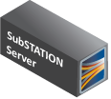
Supported Topologies
Multiple Controlling Stations
One to One
Hierarchical /
Data Concentrator
Multidrop

Slide 21
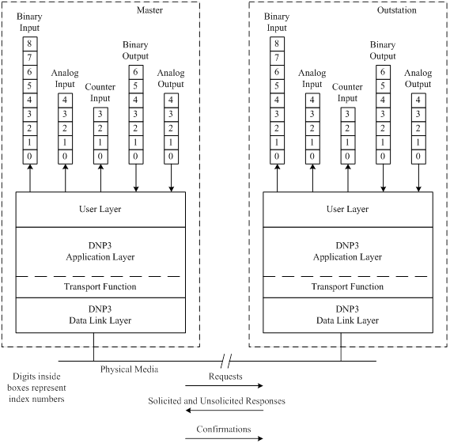
DNP3 Data Model & Data Types
Controlling Station
DNP3 models data in terms of one-dimensional arrays of data per outstation:
  Binary inputs & outputs
  Analog inputs & outputs
  Counter inputs (running & frozen)
  Blob (“string”) objects
  Data sets (structures of data)
Data identified by
  Outstation, data type & index
Notes:
.

Slide 22
Data Identification
Each data object (e.g. an individual binary input) is called a “Point”
Data for each point has a value, quality and time of measurement
For each data type (binary input, analog input, etc.)
  “Static” data reports the current state of the point
    Static does not mean “unchanging”, it just refers to the current “state” of the point
  “Event” data reports a change or an update of the state of the point
    Events might or might not indicate a change of state
    Events are sent for any reason the outstation determines is worth reporting
      Change of value
      Change of quality
      Periodic update
      Etc…

Slide 23
Data Identification
Static and event data in DNP3 messages are reported using different “Object Groups”
Each Object Group has an identifying object group number
  E.g.: Binary input static data is reported in Object Group 1 &
  binary input event data is reported in Object Group 2
Object Groups indicate how to report data for each data type
The static and event object groups associated with a specific index of a data type update the value of the same point of that type

Slide 24
DNP3 Object Groups
Controlling Station
For example:
  Binary input static data for index 3 reports the current value of the 4th binary input (indices start at 0)
  Binary input event data for the same index updates the value of that same binary input
Outstation event data is stored in
and reported from an event buffer
  When a timestamp is reported, it is the time of data or quality change or update
Notes:
.

Slide 25
DNP3 Object Groups

Slide 26
DNP3 Application Layer Payload
Each Application Layer message performs a single function
  E.g.: Read, Control command, etc.
A single message can contain multiple different data types
  E.g. Read classes and binary inputs and binary outputs
The same function is performed on all data in the message
Some functions include data group headers only; some include data group headers and object data, some have neither

Slide 27
DNP3 Data Object Structure
27
For point data:
  An Object Group can report data in various formats
    E.g.: Analog inputs can be formatted as 16-bit integer, 32-bit integer or 32-bit or 64-bit floating point
    Counters can be reported as 16-bit or 32-bit values
  The different formats of an object are known as “Variations”
    The different variations of an object type are identified by the Variation Number given in the object group header

Slide 28
DNP3 Data Object Structure
28
For point data:
  Any point can theoretically be reported in any variation
    A specific analog input could be reported as a 16-bit or 32-bit integer or as a float: The same value would be reported in whichever variation is used (subject to scaling, overflow, rounding, etc.)
    Each point has a default variation (which may be configurable in outstation)
  A controlling station may request the variation it wants reported
  Specifying Variation 0 in read requests means “any variation” (i.e. the outstation is to use the default variation)

Slide 29
DNP3 Data Object Structure
Point data objects typically consist of:
  Value
  Qualifier flags
  Timestamp (optional: events & frozen objects only)
For Static data:
  Some variations include qualifier flags, some don’t
    When qualifier flags are not reported, this means exactly the same as reporting a variation with flags where the flags indicate “On-Line with no errors”
In all cases, the Variation number indicates the format of the data object in the message
Notes:
1 highlight

Slide 30
DNP3 Data Object Qualifier Flags
5 common flags: Normal Status (all data types)
  On Line 1
  Restart 0
  Communication Lost 0
  Remote Forced 0
  Local Forced 0
Additional type-specific flags (all normally 0):
  Binary: State & Chatter Filter
  Analog: Overrange & reference error
  Counter: Discontinuity & rollover (rollover is deprecated)
Notes:
1 highlight

Slide 31
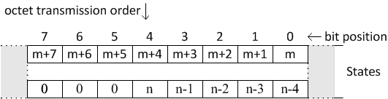

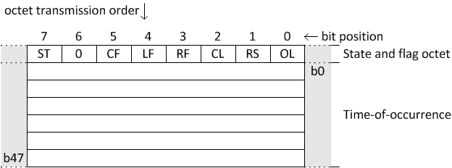
Binary Input Variations
Static (Object Group 1)
  Variation 1: Packed (index m–n)
  Variation 2: With Flags (per index)
Event (Object Group 2)
  Variation 1: Without time
  Variation 2: With time
  Etc…
Chatter Filter

Slide 32
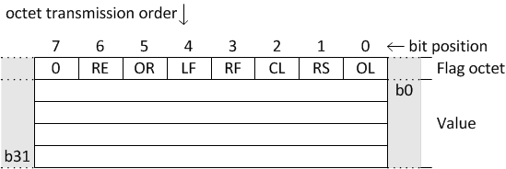
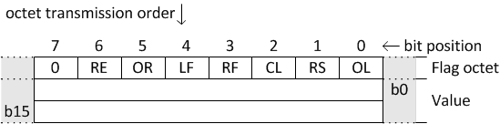
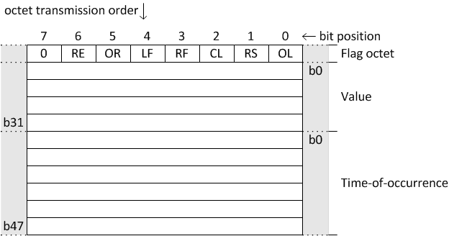

Analog Input Variations
Static (Object Group 30)
  Variation 1: 32-bit with Flags
  Variation 2: 16-bit with Flags
  Etc…
Event (Object Group 32)
  Variation 2: 16-bit without time
  Variation 7: Short float with time
Overrange
Reference Error

Slide 33
Polling
Polling is typically a periodic process
  The controlling station issues Read requests
  The outstation replies by sending the data
  that has been requested
DNP3 supports polling or
“unsolicited reporting” (or a mixture)
  An outstation may spontaneously reports changes to the controlling station, instead of being polled
Important: Unsolicited and RBE are different, but related
Time

Slide 34
Polling for Events
Systems may:
  Ignore values occurring between polls, return value at time of scan
  Report changes, including those that occur between polls (known as Event Reporting or RBE)
    after collecting
    the initial 0
Analogs & counters
  Events may indicate a significant change, a periodic update or whatever the outstation decides
Static Poll
0 1 1 1 0 0
Time
Event Poll
— 1 01 —010—
(0 1 1 1 0 0)
(— 1 01 —010—)

Slide 35
RBE Reporting Model
All changes reported as events
(with or without timestamps)
Current value need only be collected at
start up or after data loss
Use events for all SCADA data processes
  Update database
  Alarm processing
  History
RBE
Notes:
2 highlights

Slide 36
RBE Reporting
The controlling station may poll for events and static data in any combination of classes or specific data types
  The outstation returns all requested data
  If the poll request is for event data and there are no events, the response is a “null” response containing no data objects, indicating that there are no events
If unsolicited reporting is used, the outstation can spontaneously transmit event data to the controlling station in an “unsolicited response”
All outstation responses that contain events will request confirmation

Slide 37
Small Outstations
DNP3 relaxes expectations and conformance requirements for low-capability outstations, identified by database size
  An outstation is considered small if its largest possible response message is small enough to fit in a single DNP3 Data Link Frame
    I.e.: Largest message transmitted by the outstation is no larger than 292 data link frame octets or 249 octets of Application Layer data
Small outstations are not required to support RBE: They are permitted to transmit only Static data

Slide 38
Data Handling
Modern SCADA protocols use RBE
Data reported is: {Value, Quality, Timestamp}
Each consecutive measurement for each data object (point) is reported in the same order it is read
  Controlling station updates the database with data in the sequence received: the final value is the most recent value
Event buffer overflow requires re-initialization by reading all current values
Notes:
2 highlights
Note that with larger event buffers and infrequent or irregular polling, we may need to not only record when the event occurred, but when the event data was received. This is the only way that we can reconstruct what an operator actually saw at the time.

Slide 39
Internal Indications
Every message from an outstation (a “response”) contains IINs
Command error
First Octet | Second Octet
IIN1.0 Broadcast | IIN2.0 Function Code Not Supported
IIN1.1 Class 1 Events | IIN2.1 Object Unknown
IIN1.2 Class 2 Events | IIN2.2 Parameter Error
IIN1.3 Class 3 Events | IIN2.3 Event Buffer Overflow
IIN1.4 Need Time | IIN2.4 Already Executing
IIN1.5 Local Control | IIN2.5 Configuration Corrupt
IIN1.6 Device Trouble | IIN2.6 Reserved
IIN1.7 Device Restart | IIN2.7 Reserved
Loss of data

Slide 40
Control Commands
Single Pass Command
  Control command issued and immediately activated
  Subject to incorrect commands due to communications errors
Command
Activate

Slide 41
Control Commands
All high-integrity SCADA
protocols support
2-pass controls
Two Pass Command
  “Select Before Operate” (SBO) or “Select Execute”
    The first command, Select, “arms” an output and the outstation responds
    The response is checked
    If it is correct, the Operate or “activate” command is issued
    The outstation verifies that the “Operate” matches the “Select”
  Provides very high integrity against incorrect commands due to communications errors
Step 1: (Select)
ARM
Step 2: (Operate)
Activate

Slide 42
Structures and Paradigms
DNP3 is based on a set of paradigms:
  Report-By-Exception (RBE)
    An initial image of field data is reported
    Thereafter only “changes” are reported
    Uses communications bandwidth efficiently
    Requires data identification in messages
  Uses a layered structure
  Data for each object is always reported
  in the same order that it is measured
  Reporting of event data is confirmed
Notes:
3 highlights
Also note that even where the time change is substantial (let’s say the clock drifted a bit more than expected), and event time stamps appear to be out of order, the outstation must still report the events in the order they were received, NOT ACCORDING TO TIME STAMP.

Slide 43
DNP3 Classes
43
In DNP3, Classes are used to collect together various kinds of data
  Consider a Class to be a shorthand for identifying some set of data
  An action performed on a Class is the same as an action performed on the entire set of data objects assigned to that Class
Note for programmers: Classes in DNP3 are not “data structures”
  DNP3 Object Groups and their Variations are “data structures” in messages
Each class may be polled with a different period

Slide 44
DNP3 Classes
A single class, Class 0, is the set of all kinds of static data
  Class 0 may be considered to be identical to the set of static data for each kind of data point in a device:
    Reading Class 0 is equivalent to reading all binary input static data and all analog input static data and all counter input static data, etc.
    Devices may also include output point static data in Class 0
  Reading Class 0 returns the current state of all data inputs
    It is possible to configure inputs to not be part of Class 0, in which case they are not part of the reply to a read of Class 0 and they will not report events

Slide 45
DNP3 Classes
Three classes, Classes 1, 2 and 3 are sets of event data
  The three classes may be considered as separate collections of points
  Each event class may be polled at a different period or they may be polled at the same period
    Polling different classes at different periods assigns a different priority or maximum data latency to the class
    There is no inherent ordering of priority of the event classes, the priority or periodicity of reporting depends on the system configuration
  If events are to be reported for a point, its static value must be reported as part of the Class 0 data for the device
Event data is buffered

Slide 46
DNP3 Classes
Except for very small outstations, all DNP3 devices are required to support event reporting
Normal DNP3 operation is by Class Polling
  A combined poll for Classes 1, 2, 3 & 0 is an integrity poll
    Synchronizes the outstation and controlling station databases
    Required at startup or after buffer overflow, may be requested occasionally
  Events are periodically collected by requesting Classes 1, 2 and 3
    May be polled together or independently

Slide 47
DNP3 Classes
Classes are “shorthand” descriptions for groups of other objects
  Class 0 is a shorthand reference meaning the same thing as specifying all the static data types
  Classes 1, 2 & 3 are groups of event objects
    Specifying a class is a shorthand way of specifying the set of objects that report events in that class
    Allows selection of three different reporting priorities
The controlling station can read objects or classes
  For object types: all objects of that type, or specific objects
  For event classes: all events or a maximum number of events
Notes:
2 highlights

Slide 48
DNP3 Classes
The purpose of Class 0 is to collect all device data at startup: To capture an “initial database image”
  An “Integrity Poll”: Must also collect events: Classes 1,2,3 & 0!
All Static data is included in Class 0
Event Classes allow grouping or prioritization in whatever manner the user chooses
  There is no implied priority of the three Event Classes
It is possible to request either all events from the buffer(s) or a limited number of events from the buffer(s) in an event class poll
Notes:
1 highlight

Slide 49
DNP3 Classes
All Outstations (except small outstations) must permit data points to be assigned to any Class or to no class
  Any point assigned to Classes 1, 2 or 3
    Reports Event data in the assigned Class
    Also reports Static data in Class 0
  Any point assigned to Class 0
    Does not report events in any Class
    Reports Static data in Class 0
  Points assigned to no class
    Do not report events in any Class
    Do not report Static data in Class 0
    Will report their static data when read by data type
Reported in Class 0
Reported in Class 1
Reported in Class 2
Reported in Class 3

Slide 50
DNP3 Event Buffering
Conceptually:
  Separate buffer per Event Class (1, 2 or 3)
Buffering is FIFO
  All events are reported in
  the order of occurrence of
  whatever information they
  are reporting
When the evens that were
reported are confirmed, they
are removed from the event buffer

Slide 51
DNP3 Layers (EPA Model)
User Layer
Application Layer
Physical
  Media and network interfaces
Data Link
  Handles link control, frame checks,
  addressing
Transport (function or pseudo-layer)
  Assembles message fragments
Application Layer
  Defines DNP data objects and services
Session Layer
User Layer
From SAv6
Application Layer
Transport Function
Transport Function
Data Link Layer
EPA Model
Physical Layer
Communication Medium

Slide 52
DNP3 Layer Terminology
52
Data Link FRAME
  A complete data link message
Transport SEGMENT
  A Data Link Frame with Transport Header
  Between DNP3 Application Layer and Data Link Layer
Security SPDU (starting from SAv6): Session Protocol Data Unit
Application FRAGMENT
  A complete, parseable collection of Segments
Application MESSAGE
  A complete message (one or multiple Application Fragments)

Slide 53
DNP3 Message Components
DNP3-SA

Slide 54
DNP3 Link Layer Usage
54
For almost all applications:
  Only Unconfirmed User Data Service is used
    No need for any secondary messages
    No need to perform Reset Link States command
    Traffic is minimized
Only use data link confirmation if required for flow control
  Usually only needed for devices that are unable to buffer a complete Application Fragment
Notes:
1 highlight

Slide 55
DNP3 Application Confirmation
55
When reporting events, outstations request application confirmation
  When the controlling station confirms receipt of data, the reported events are cleared form the event buffer
    If not confirmed, the data remains buffered and is reported in a subsequent response
When reporting a non-final fragment, outstations request app confirm
  Receipt of the confirm indicates to the outstation that it is to transmit the next fragment
  The final fragment will request application confirmation if it contains events
Application confirmation is requested by setting the “Confirm” flag in the Application Header of the response message

Slide 56
DNP3 Command Summary
Data are collected using READ commands
Data can also be reported in Unsolicited messages
Output objects can be read
  This acquires their flag status: Not usually required by all systems
Time (the Outstation’s clock) can be written
Internal Indication “Device Restart” flag is cleared by setting it to zero by a write command
Outputs are controlled with SELECT, OPERATE and DIRECT OPERATE
Outputs are NOT issued by using WRITE commands

Slide 57
DNP3 Subset Levels
Subset Levels provide a way for DNP3 to identify commonly used sets of objects and functions
Subset Level 1 permits Class polls and control commands
Subset Level 2 permits Data Type polls & supports frozen counters
Subset Level 3 permits individual object polling and adds some advanced features
Subset Level 4 includes all basic data types
Normal DNP3 Operation uses Subset Level 1 functions

Slide 58
DNP3 Output Commands
DNP3 Supports direct execute or Select-Before-Operate (1-pass and 2-pass) commands on both binary outputs and analog outputs
Binary outputs are controlled through the CROB (control relay output block, Object Group 12, Variation 1)
Analog outputs are controlled through the analog output block (Object Group 41)
It is permissible (but unusual) to issue multiple control commands in one message

Slide 59
DNP3 Binary Outputs
The CROB can accept many parameters
The basic implementation permits:
  Trip/Close
  Latch On/Latch Off
  Pulsed contact closure
Paired commands may be issued to one index or to a pair of indices
The controlling station is required to be configurable to match the outstation’s requirements
  The specification requires this;
  conformance tests are only passed
  if the device implements this capability
Notes:
1 highlight

Slide 60
Binary Output Models
Activation model
  Control commands initiate an action: A “start” command

Slide 61
Binary Output Models
Complementary Latch model
  Control commands operate to two states: On/Off, Start/Stop, etc.

Slide 62
Binary Output Models
Complementary Two-Output model
  Control commands operate to two states: On/Off, Trip/Close, etc.

Slide 63
DNP3 Unsolicited Reporting
Outstation is permitted to spontaneously report events (and requests the controlling station to issue confirm)
Startup behavior changed in DNP3-1999:
  Outstation sends empty “restarted” message
  Controlling Station issues “enable unsolicited” command
  Prior behavior did not require “enable unsolicited”
Collision avoidance and backoff
  Configure sensible backoff times!
Notes:
1 highlight

Slide 64
DNP3 Poll Transaction Sequence
User
Layer
Application
Layer
Transport
Function
Data Link
Layer
Data Link
Layer
Transport
Function
Application
Layer
User
Layer
Poll
Read
request
fragment
Read
request
fragment
User Data Frame
Ack¹
Find data
Data
Time
User Data Frame
Read
Response
1st fragment
Ack¹
User Data Frame
Read
Response
1st fragment
Ack¹
User Data Frame
Data
Ack¹
Confirm
Ack¹
User Data Frame
Confirm
Events
Confirmed
User Data Frame
Read
Response
2nd fragment
Ack¹
User Data Frame
Read
Response
2nd fragment
Ack¹
User Data Frame
Data
Ack¹
Confirm
Ack¹
User Data Frame
Confirm
Events
Confirmed
¹ Ack frames are transmitted only if the user data frames require confirmation
Notes:
TODO: ACW clean up

Slide 65
DNP3 Unsolicited “Response”
User
Layer
Application
Layer
Transport
Function
Data Link
Layer
Data Link
Layer
Transport
Function
Application
Layer
User
Layer
Unsolicited
response
Events
Time
User Data Frame
User Data Frame
Unsolicited
response
User Data Frame
Data
Confirm
User Data Frame
Confirm
Events
Confirmed
Unsolicited responses are always a single fragment in size

Slide 66
DNP3 LAN/WAN Usage
DNP3 on LAN/WAN specification
  First published December 1998
  Specifies UDP/IP for single-segment LANs
  Specifies TCP/IP for WANs and multi-segment LANs
  Assigned TCP/UDP port number 20000
  Adds time sync function for single-segment LANs
Encapsulates “serial” DNP3 in an IP packet
Adds 56-byte packet overhead in TCP/IP
Notes:
1 highlight

Slide 67
DNP3 Operation over IP
Logical Communications
Controlling Station
Outstation
Application Fragment
DNP3 Application
Layer
DNP3 Application
Layer
Transport Segment
DNP3 Transport Function
DNP3 Transport Function
DNP3 Protocol
Data Link Frame
DNP3 Data Link Layer
DNP3 Data Link Layer
Connection Management
Connection Management
DCSI: Defined in
DNP3 Specification
TCP, UDP
Transport
Transport
IPv4, IPv6, ICMP, IGMP
Network
Network
Internet Protocol Suite
Device driver/hardware
Link/Physical
Link/Physical
TCP/IP Network
Notes:
.

Slide 68
Interoperability

Slide 69
DNP3 The Easy Way
At startup, clear the Device Restart flag & Issue a combined
Class 1, 2, 3 & 0 (integrity) poll
Periodically issue a combined Class 1, 2, 3 poll (or individually at different rates)
When the device requests time synch, issue a write time request
Messages containing events request confirmation
  Controlling station sends an Application Confirm after processing the message
    The Outstation clears the events from the event buffer after receiving the Application Confirm
Notes:
2 Highlights

Slide 70
The most common error
Systems that pass initial installation testing sometimes later fail in operation in this manner:
  Outstation reports buffer overflow (loss of events)
  Controlling station performs integrity poll to recover data
  Cycle repeats
Reason: Application confirmation timeout is configured too short
  The outstation never successfully reports and clears event buffers
To avoid this: During commissioning testing, verify operation with maximum messages sizes

Slide 71

Summary
71
DNP3 is still actively being enhanced to support utility industry goals
All DNP3 documentation is available to DNP3 Users Group members
  Anyone implementing or using DNP3 should be a member!
All DNP-UG members can contribute to
technical and cybersecurity committees
More information at www.dnp.org

Slide 72
Thank you for your participation
Complete the post-course survey in order to receive certificate of attendance for PDH

